Slide 1
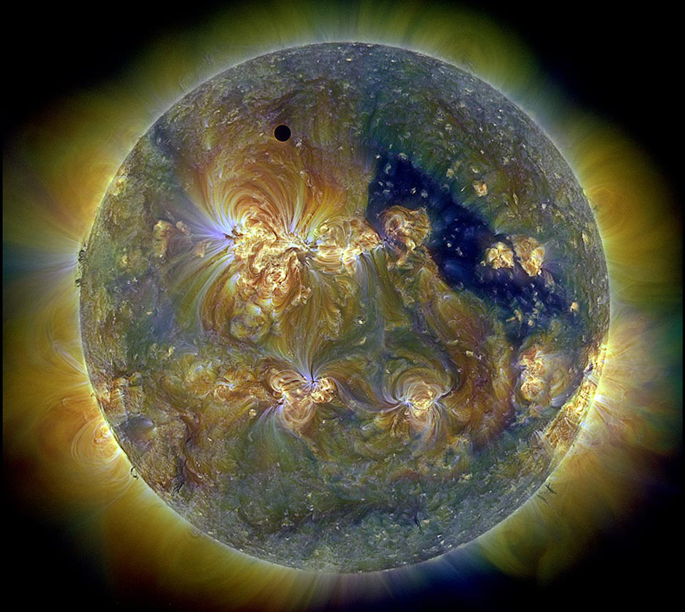
Science a world of great truth
What is science?
By
Abilash Chittan
Notes:
Abliash Chittan is an undergraduate physics major in Coimbatore, India. This presentation was developed in conjunction with Deborah Scherrer of the Stanford Solar Center, under NASA contracts for SDO/HMI and IRIS. March 2014.
Image: Solar image, in ultraviolet light & false-color. The small dot in upper center is Venus transiting the solar disc.
From NASA’s Solar Dynamics Observatory, AIA instrument. Courtesy Mark Cheung at Lockheed Martin Solar and Astrophysics
Laboratory.

Slide 2
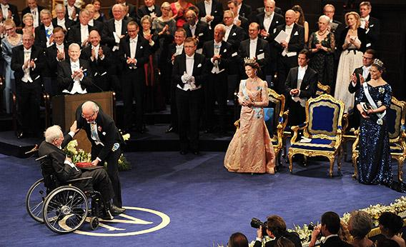
Science is definitely NOT about making money or publishing in journals, nor obtaining fame in international circles, as many think.
Notes:
Photo by Pascal Le Segretain/Getty Images.

Slide 3
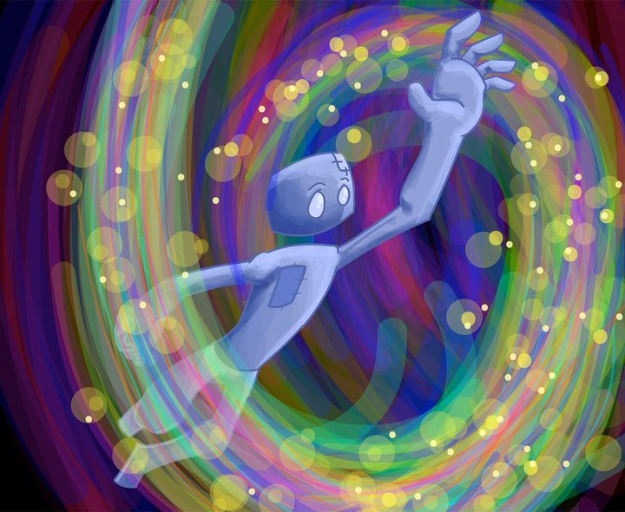
Science is about….
Going beyond your own natural curiosity
Following your passion
Using your own unrestrained spirit
to explore!
Notes:
Image credit: http://chakracenter.files.wordpress.com/2012/09/spirit-science-dream-spin.jpg It is not clear who the artist is, but it may be Jordan David.

Slide 4
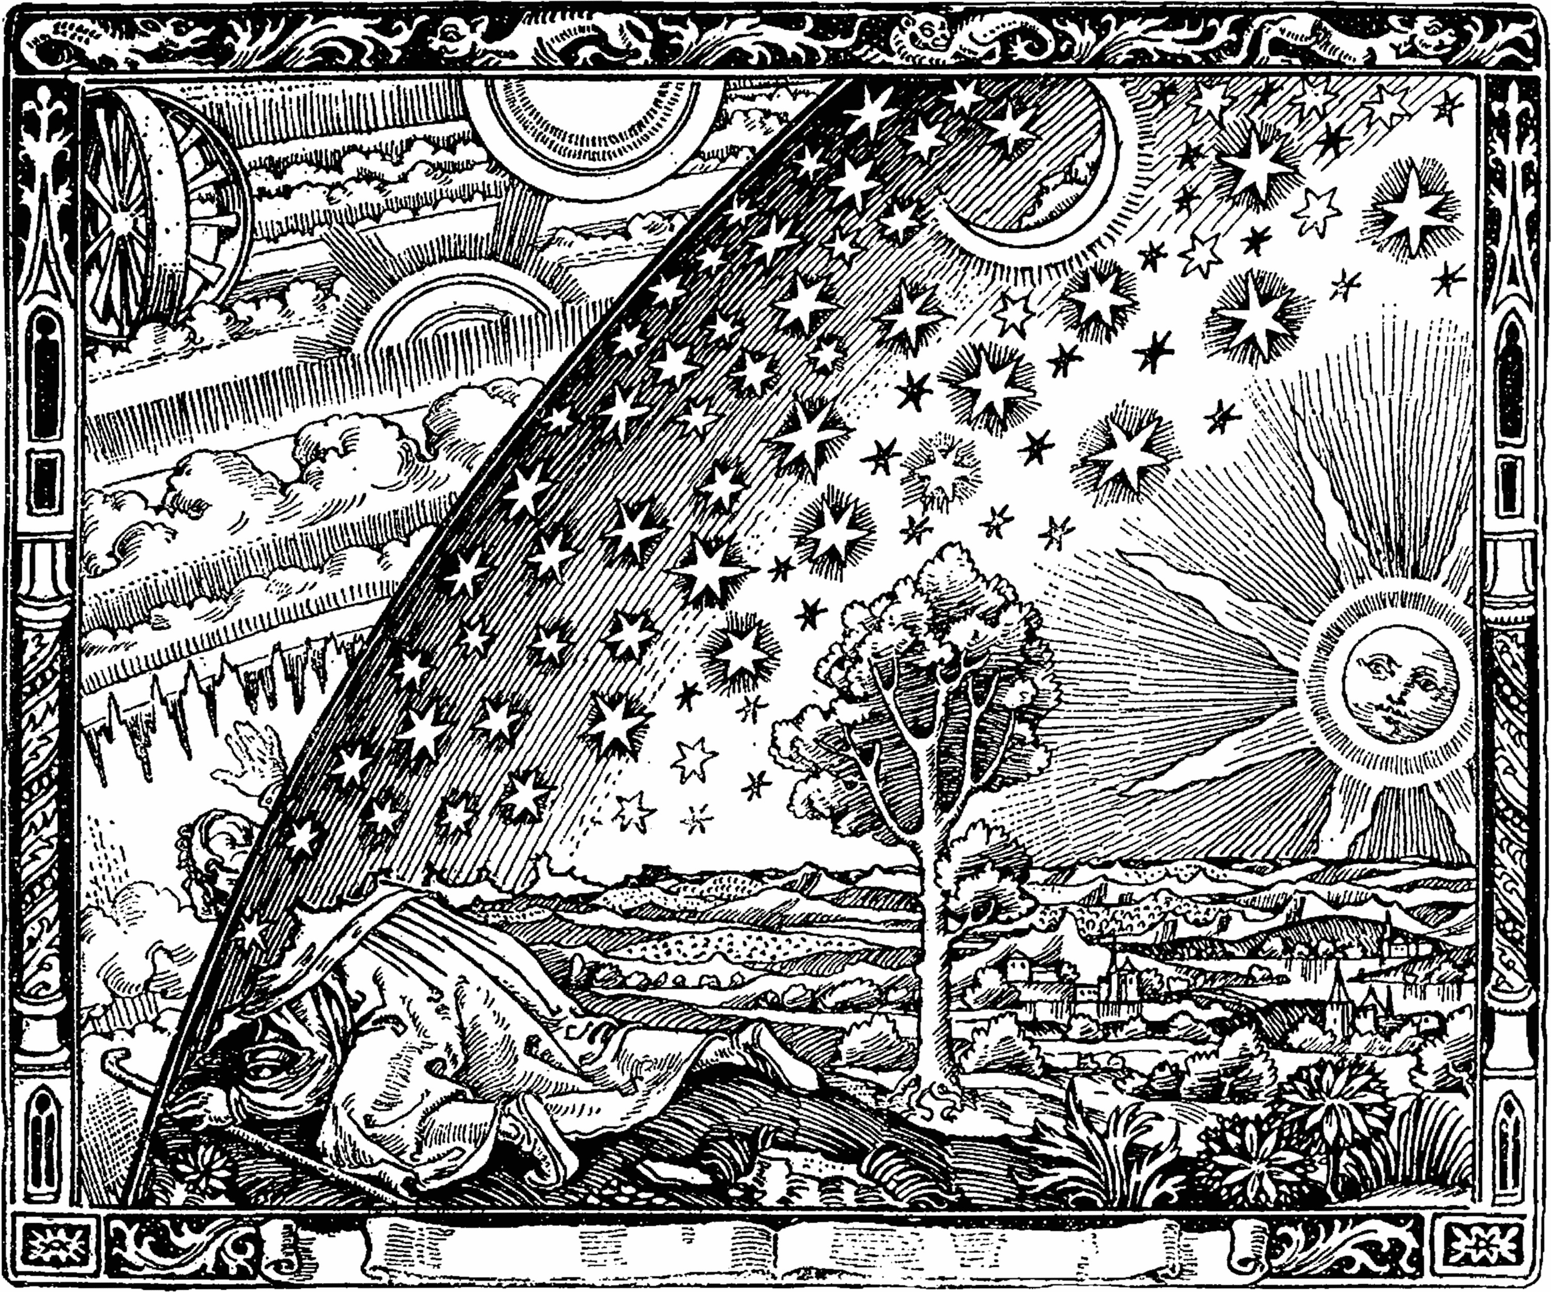
Truth, the key part of science
Science is all about discovering the scientific truth in a logical manner
The prerequisite is curiosity!
Science is all about your motivation by curiosity
Notes:
Image: Flammarion engraving showing metaphorical illustration of the scientific (or the mystical) quest for knowledge. Courtesy Wiki commons. Image from http://en.wikipedia.org/wiki/Flammarion_engraving

Slide 5
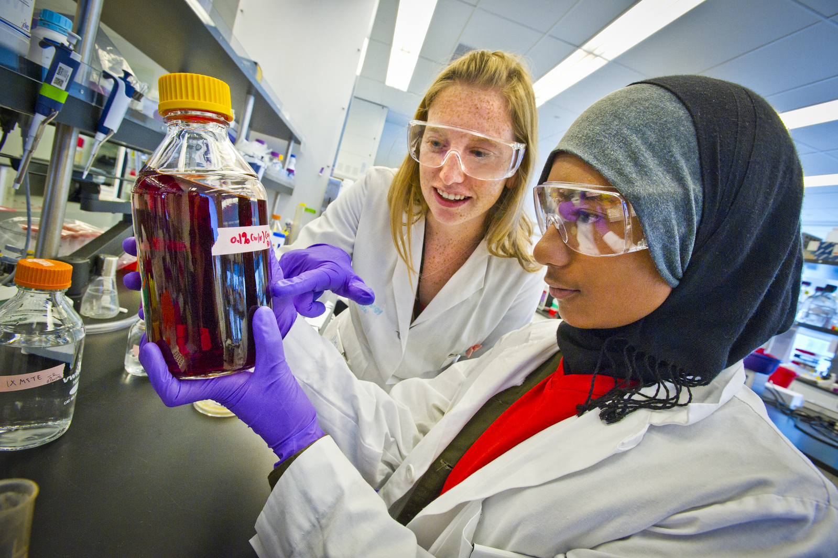
Methods of Doing Science
Science involves stages:
A curious, inquiring mind forms up scientific principles, and
Notices patterns, and
Tries to make sense of patterns, and
Locates and understands what is already known, and
Follows curiosity -- using one’s brain to try to understand
Notes:
Image credit: Photo by Roy Kaltschmidt, Lawrence Berkeley Lab
http://newscenter.lbl.gov/news-releases/2012/07/16/iclem-2012/

Slide 6
Curiosity arises from observing nature and asking questions
Why is nature the way it is?
How do we come to know that?
How does that work?
Why does the sphere shape evolve in nature?
How is the atom assumed to be a sphere?
Why does the Moon look yellow at night?

Slide 7
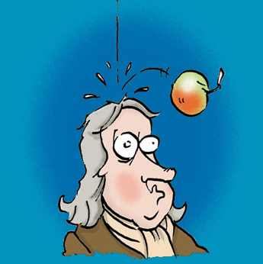
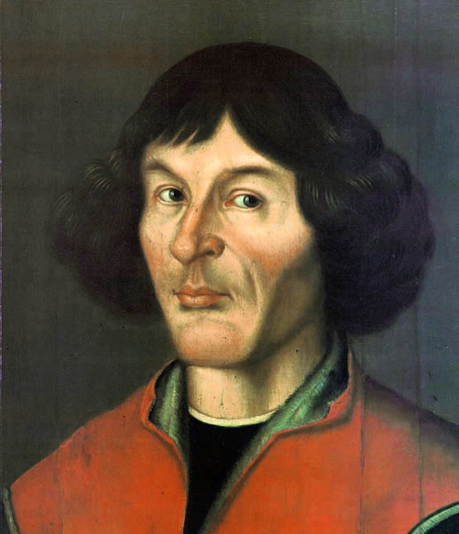
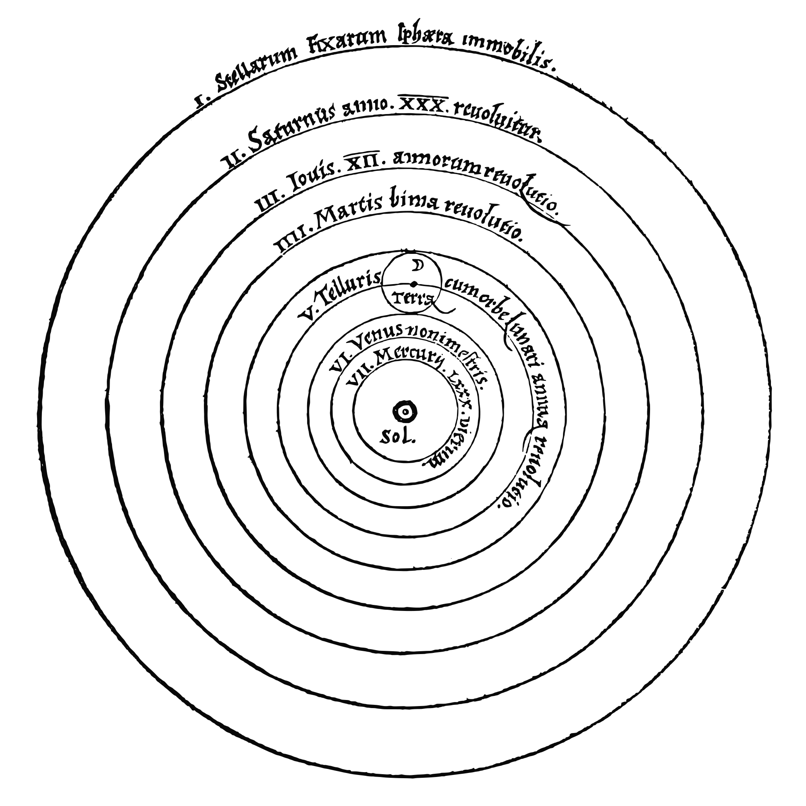
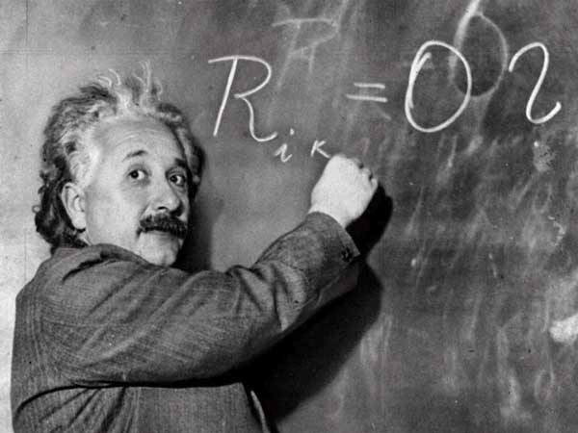
Great Examples of Curiosity
Nicholas Copernicus
Sir Isaac Newton
Albert Einstein
Notes:
Sir Isaac Newton cartoon displays the mythical apple that dropped on Newton’s head to trigger the concept of gravity.
Albert Einstein
Nicholas Copernicus: Portrait, 1580, Toruń Old Town City Hall
Image of heliocentric model from Nicolas Copernicus' "De revolutionibus orbium coelestium".
Courtesy Wiki commons

Slide 8
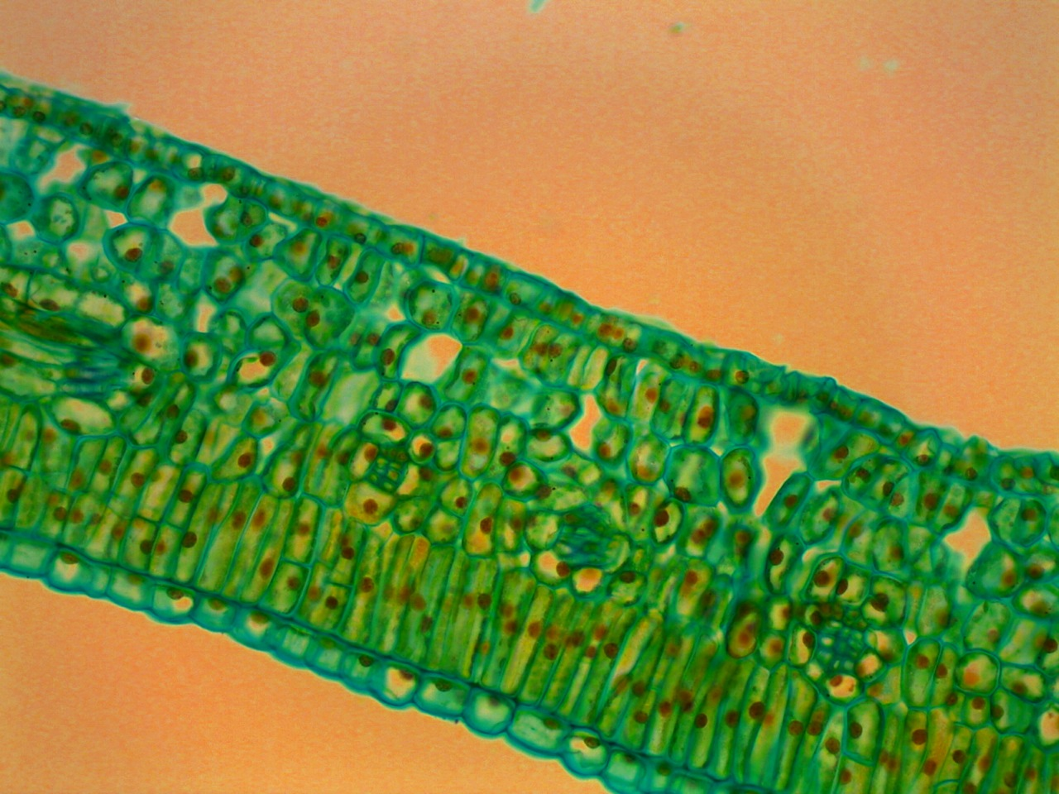
To Daniel Schechtman, 2011 Nobel Laureate in Chemistry, the factor which initiated his curiosity was “looking into a small leaf using a microscope and deriving joy…”
8
Notes:
Image: Dyrophytic leaf cross section stained microscope slide. Courtesy of Wiki Commons
http://commons.wikimedia.org/wiki/File:Hydrophytic_Leaf_Cross_Section_Stained_Microscope_Slide.jpg

Slide 9
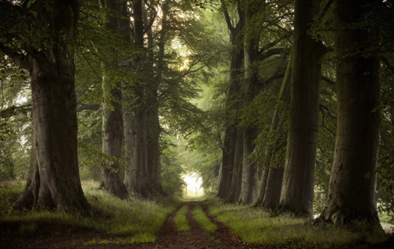
The Road to Truth
There are only 2 mistakes one can make along the road to truth,
not going all the way and not starting.
- Buddha
Notes:
The image of the peaceful path from:
http://slickzine.com/nature/10-incredible-pictures-of-nature-taken-by-amateurs/1347947098000/
There is no indication of the photographer.

Slide 10
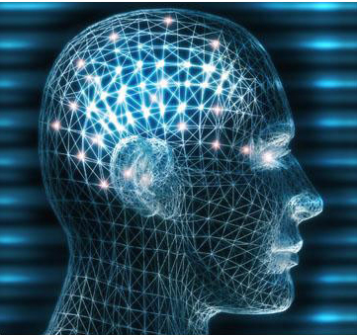
Different roads to truth
People have different brains, which gives them the ability to think and act in different ways.
What invites their scientific curiosity is not all the same.
Hence the road to truth for everyone is not the same, and need not be.
Notes:
Image credit: UC Berkeley

Slide 11
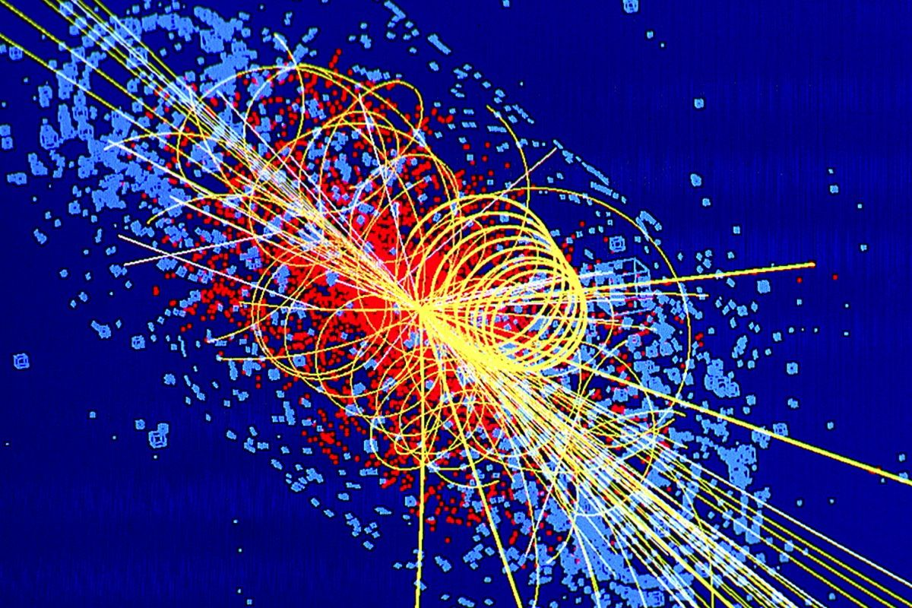
Questions
Beauty leads to questions that lead to discovery of patterns in the way nature works.
For every curious scientist, patterns suggest different things. There are patterns to the atom and other patterns for subatomic matter such as electrons and protons.
Notes:
Computer simulation of particle traces from an LHC collision in which a Higgs Boson is produced. (c) CERN. Image credit: Lucas Taylor
Image is on a public website and explicitly made available for download as long as credit remains.

Slide 12
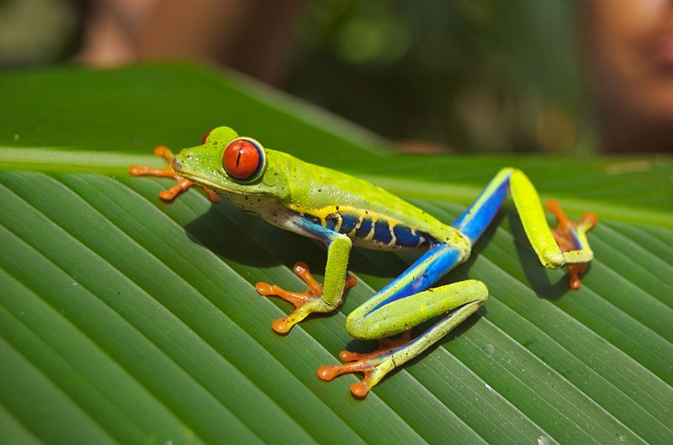
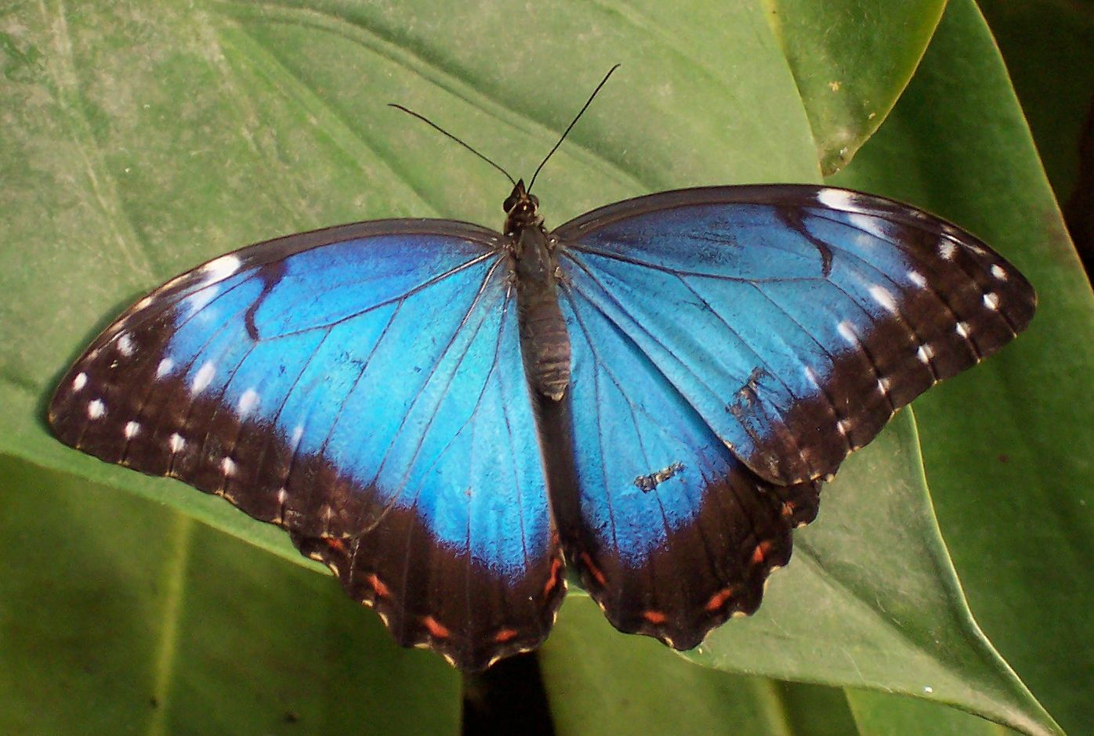
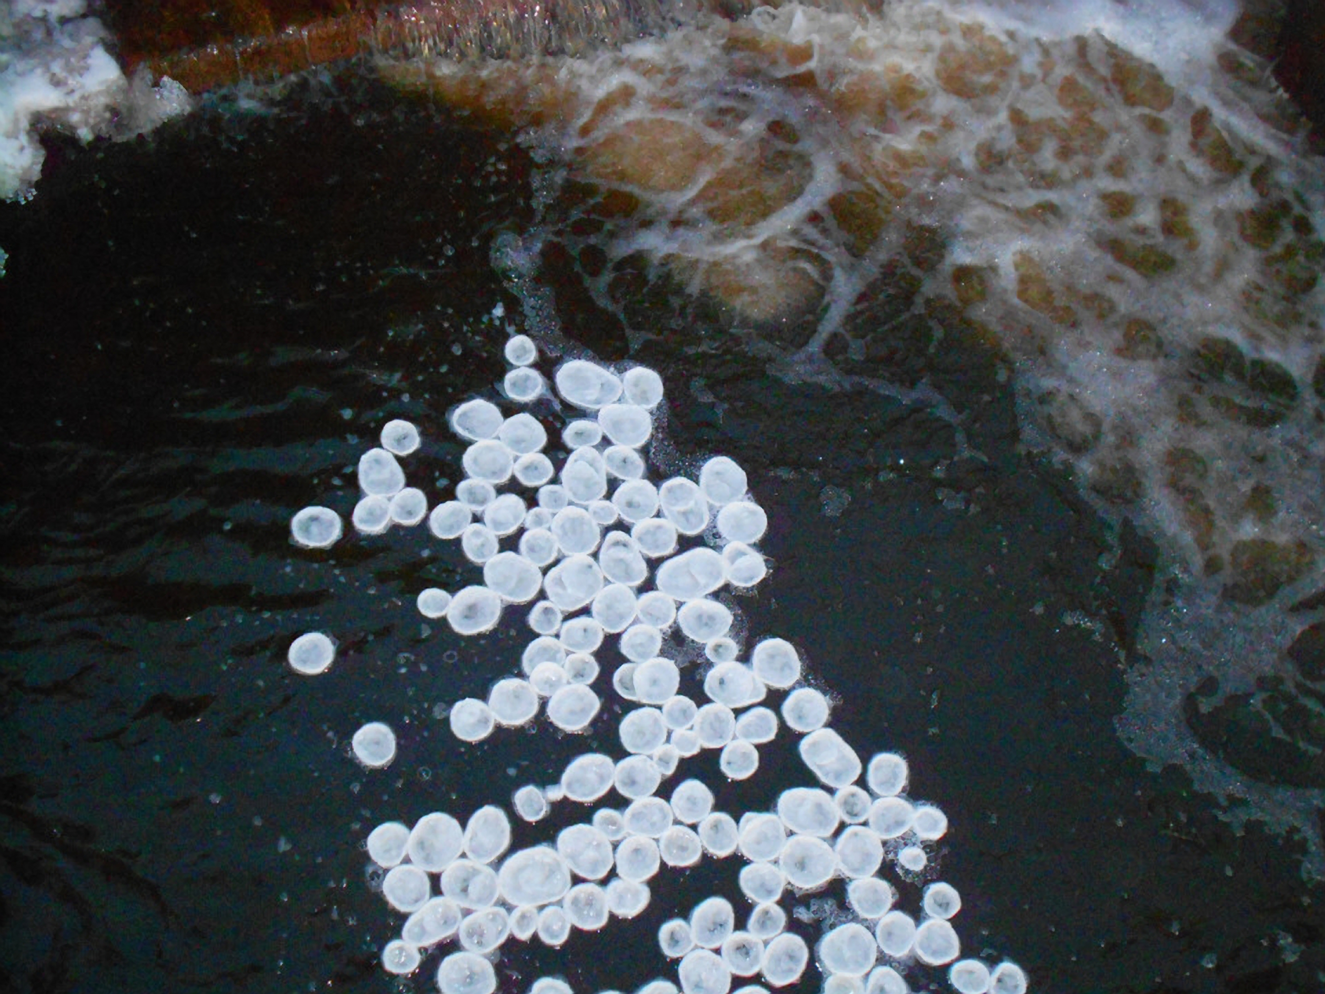
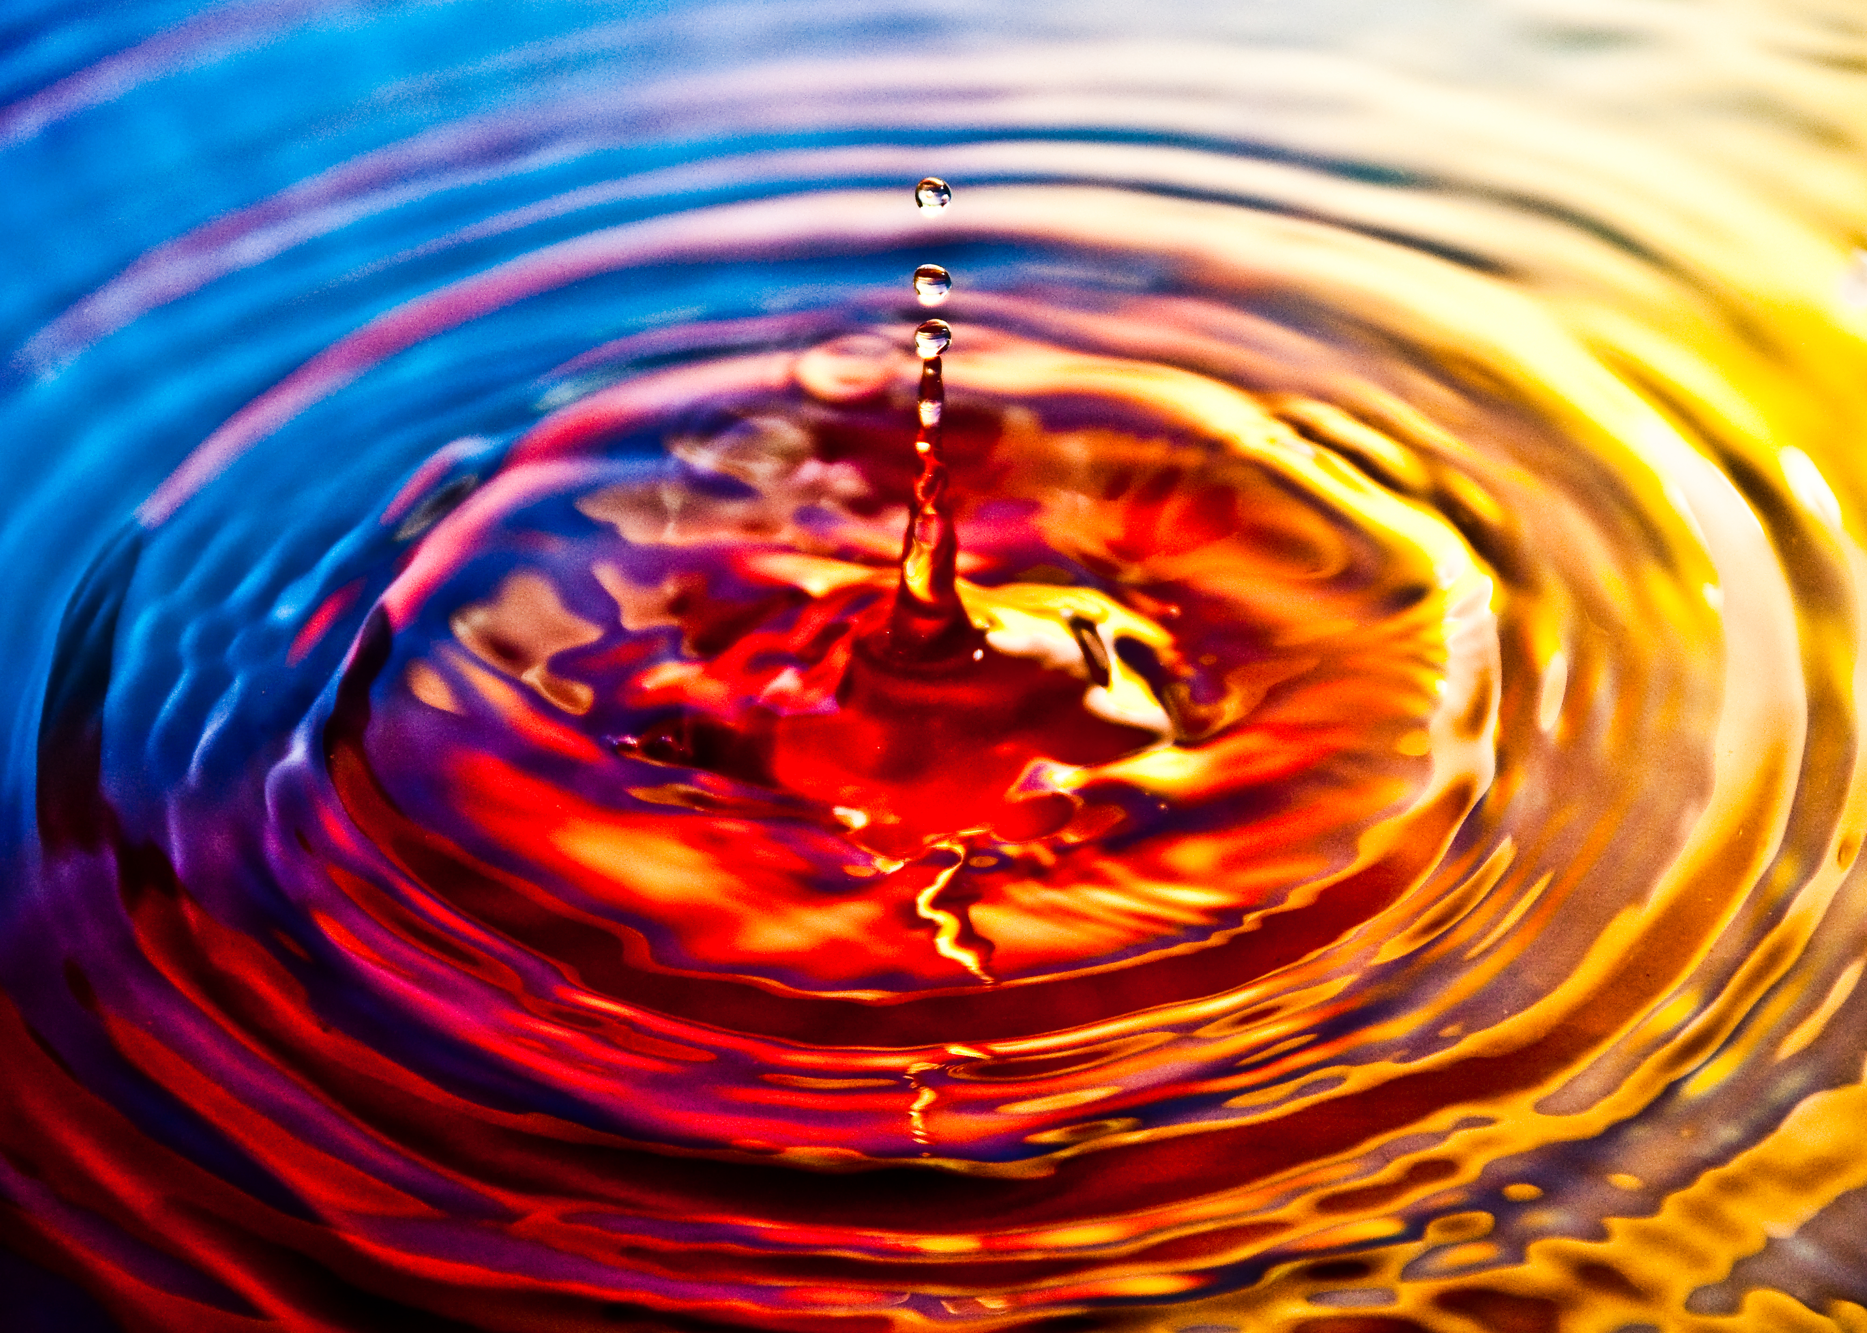
There is so much beauty in nature…to be curious about…
Notes:
Buttefly image: Morpho peleides (blue Morpho). Courtesy Wiki commons. http://en.wikipedia.org/wiki/File:Tropical_butterfly.jpg
Frog image: Red eyed tree frog; Wiki commons & public domain
Ripple effect on water courtesy Wiki Commons.
Ice pans from http://thecloakedhedgehog.wordpress.com/photo “Excerpts and links may be used, provided that full and clear credit is given to The Cloaked Hedgehog with appropriate and specific direction to the original content.”

Slide 13
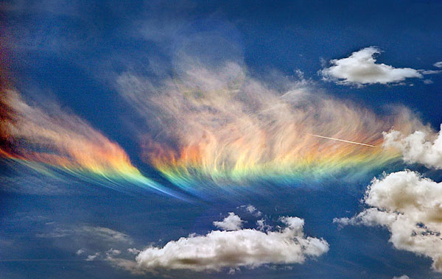
To every brain that evolves, beauty means different things
Notes:
Circumhorizontal arc image courtesy of Wiki Commons

Slide 14
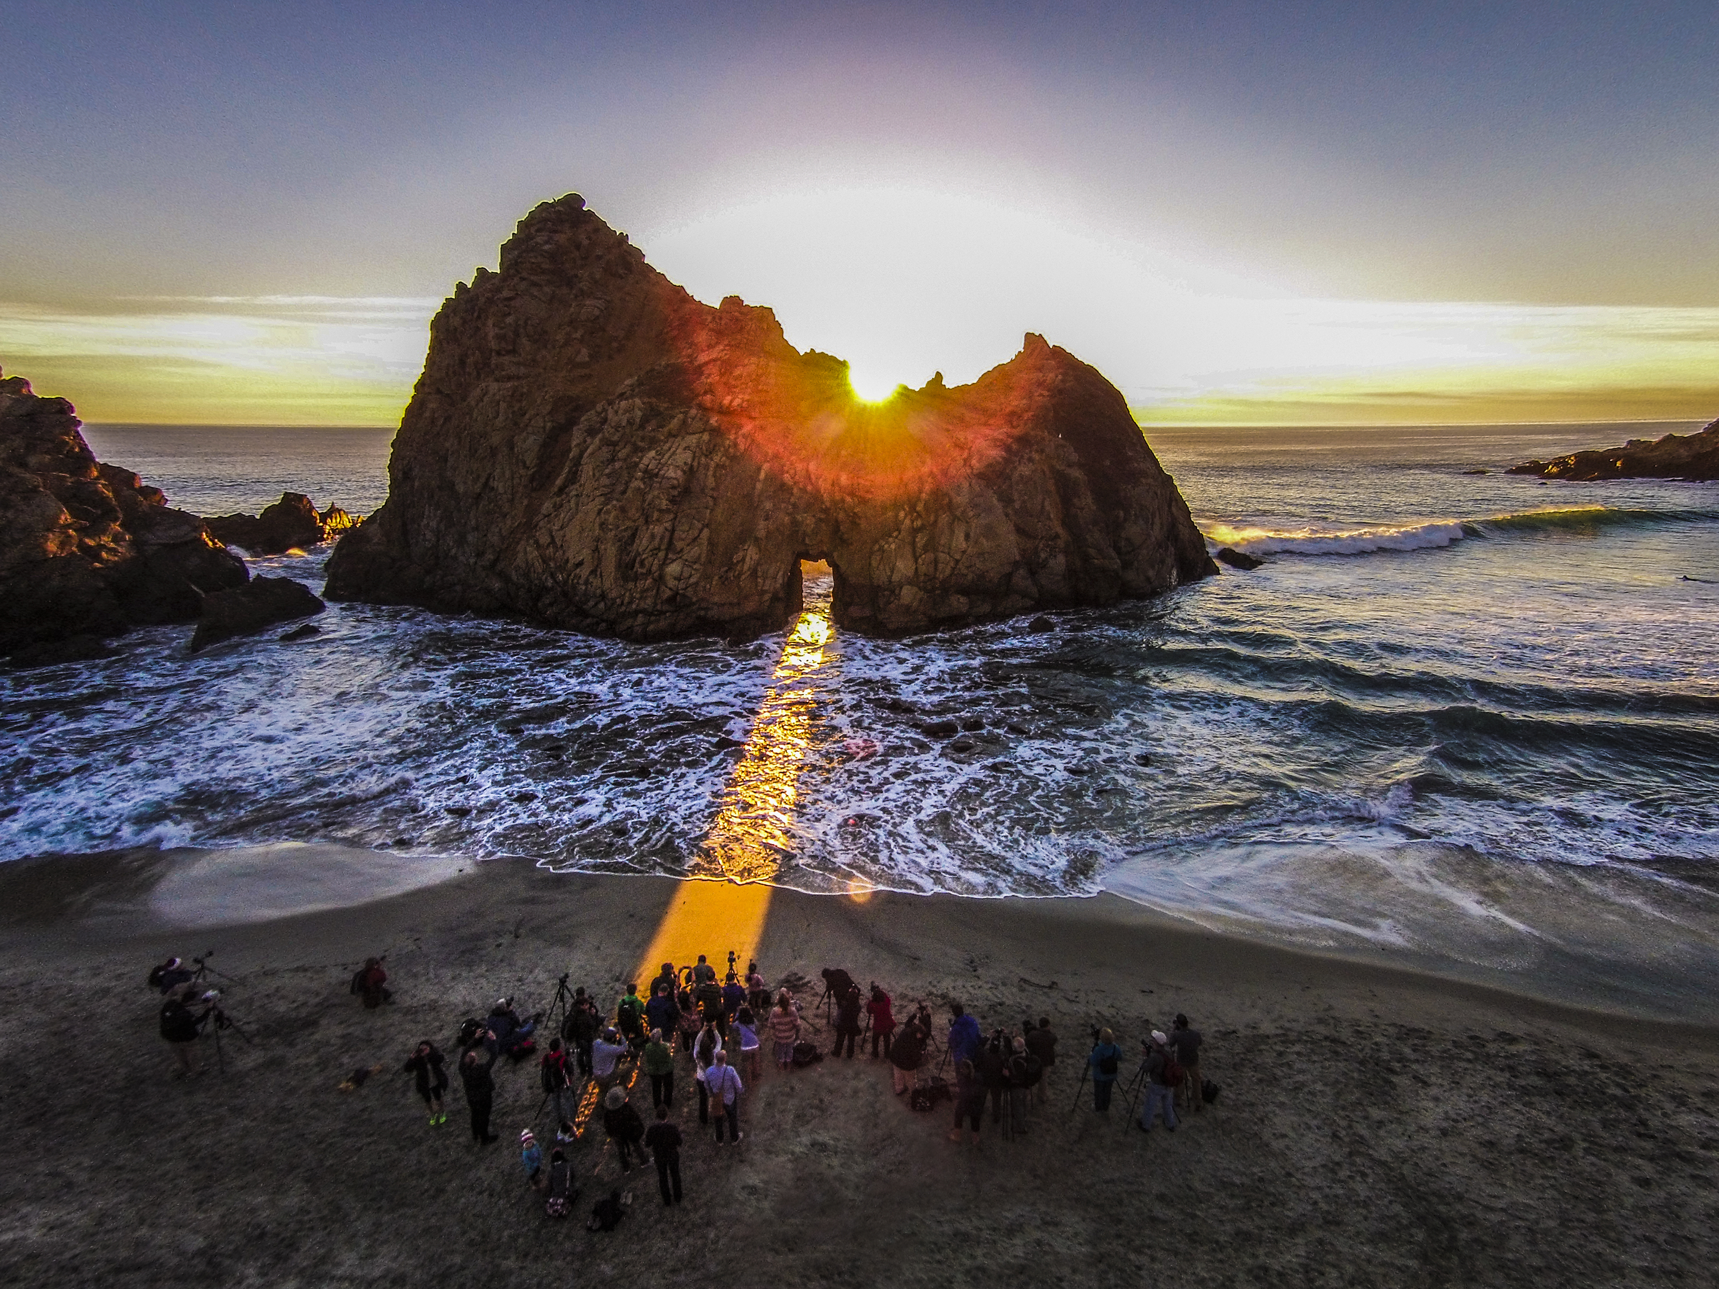
Light is an element of beauty
The physical form of light, visible light, is beautiful to look at.
Displays of light in Nature can be appreciated even when not connected with a basic truth
Notes:
A beam of sunlight shines through a natural hole in Keyhole Rock, near Big Sur in California, USA. Coincidentally, this display only happens at the few days around Winter Solstice, though the hole is completely natural.
Image courtesy of Romeo Durscher, Stanford University.

Slide 15
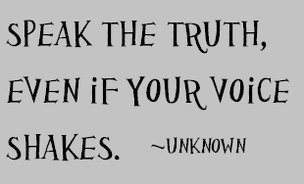
Science is a human philosphy
Science is a human philosophy to determine the truth with some degree of reliability.
Truth should be made evident in the way a scientific statement is made.
Notes:
Image credit: Annika Victoria
http://www.pineneedlecollective.com/2012_10_01_archive.html
Used with permission under creative commons license: http://creativecommons.org/licenses/by-nc-nd/4.0/

Slide 16
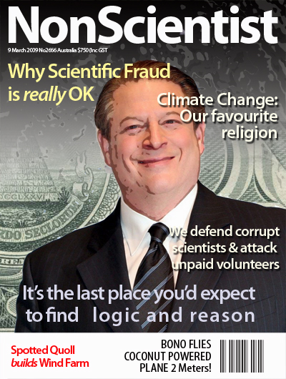
Scientists do not accept anything in the universe without strongly questioning, although we are all constantly bombarded with lies.
Science is a tool to remove ignorance
Notes:
Satirical image by Joanne Nova, used with permission.
http://joannenova.com.au/2009/12/new-scientist-becomes-non-scientist/

Slide 17
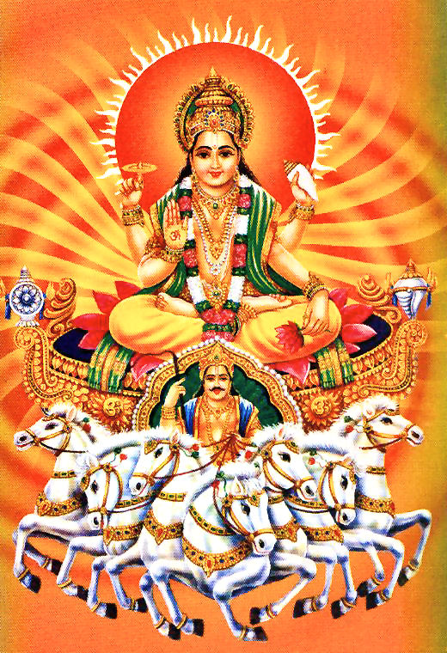
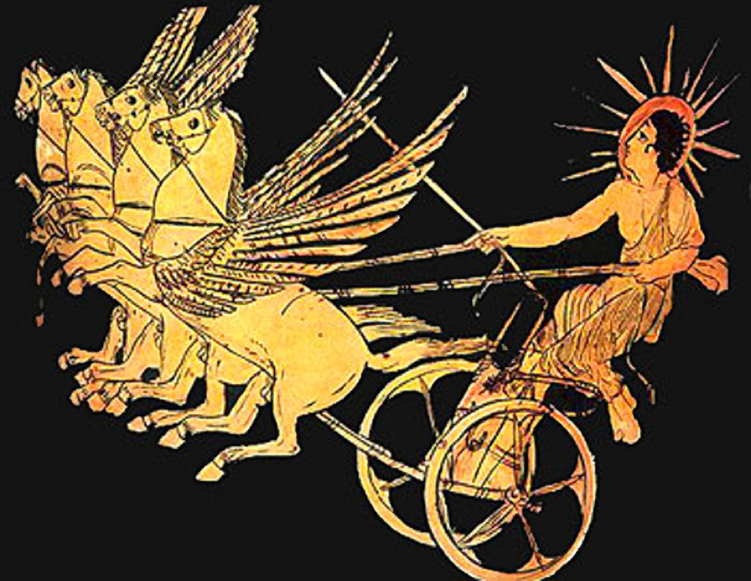
Ancients once believed that the Sun was a god or a ghostly spirit.
Thanks to scientists like Copernicus and Sir Isaac Newton, we now know what the Sun is and why it rises and sets.
Notes:
Image: Helius god of the sun, Athenian red-figure krater. C5th B.C., British Museum, London
Image: Surya, Hindu sun god, Courtesy Wikia.

Slide 18
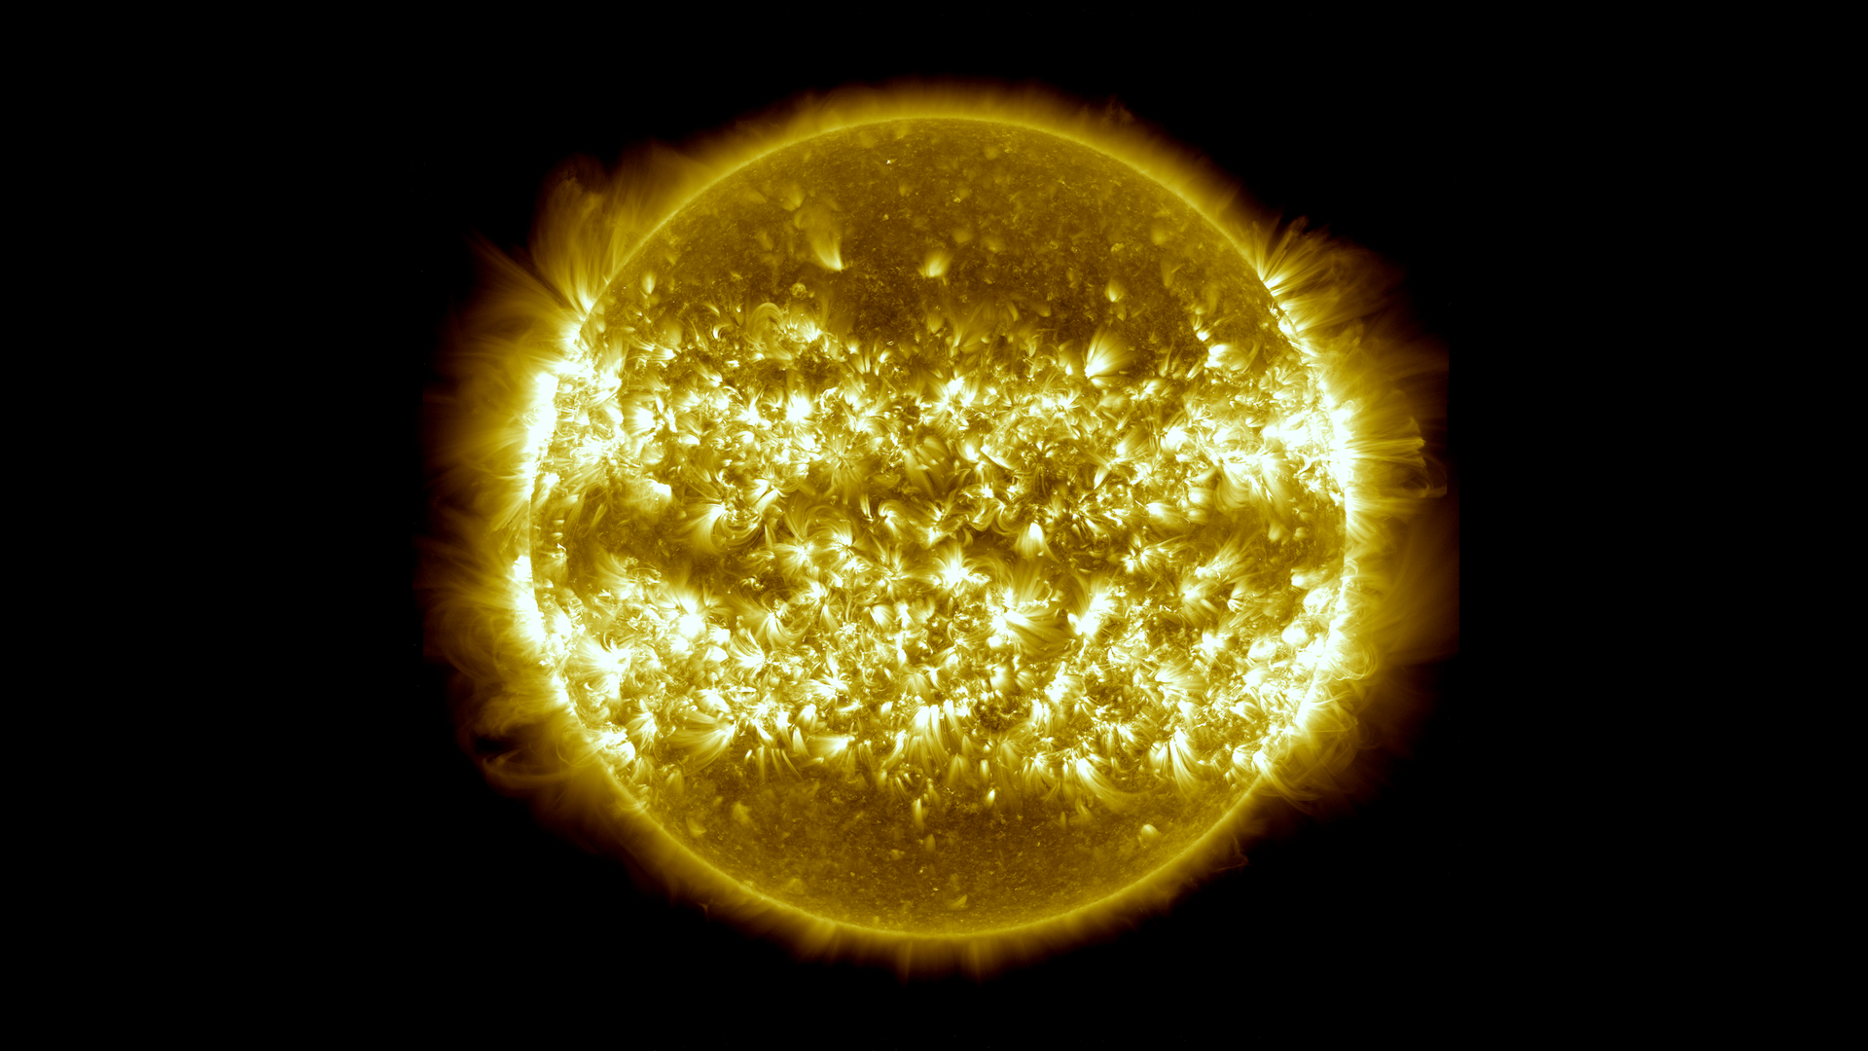
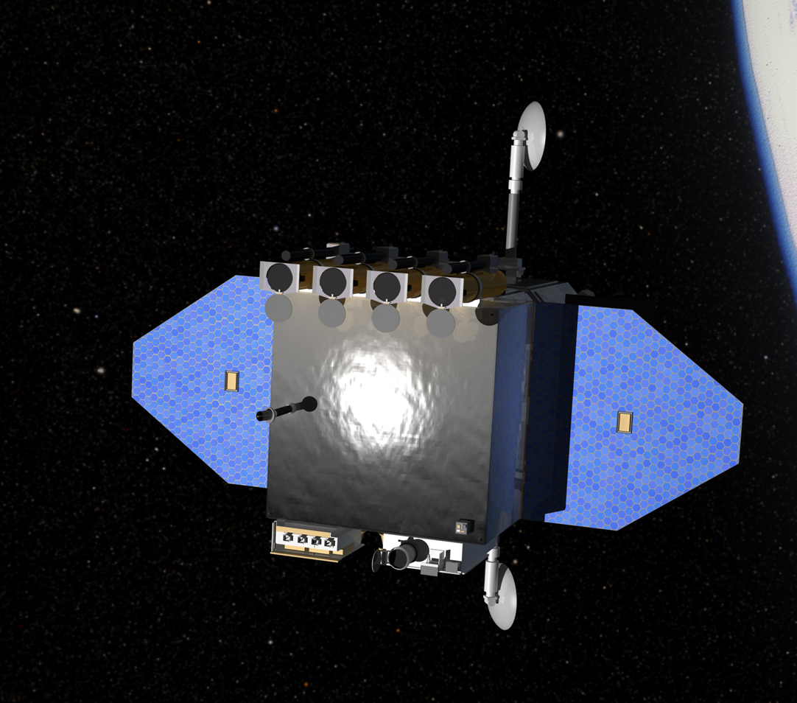
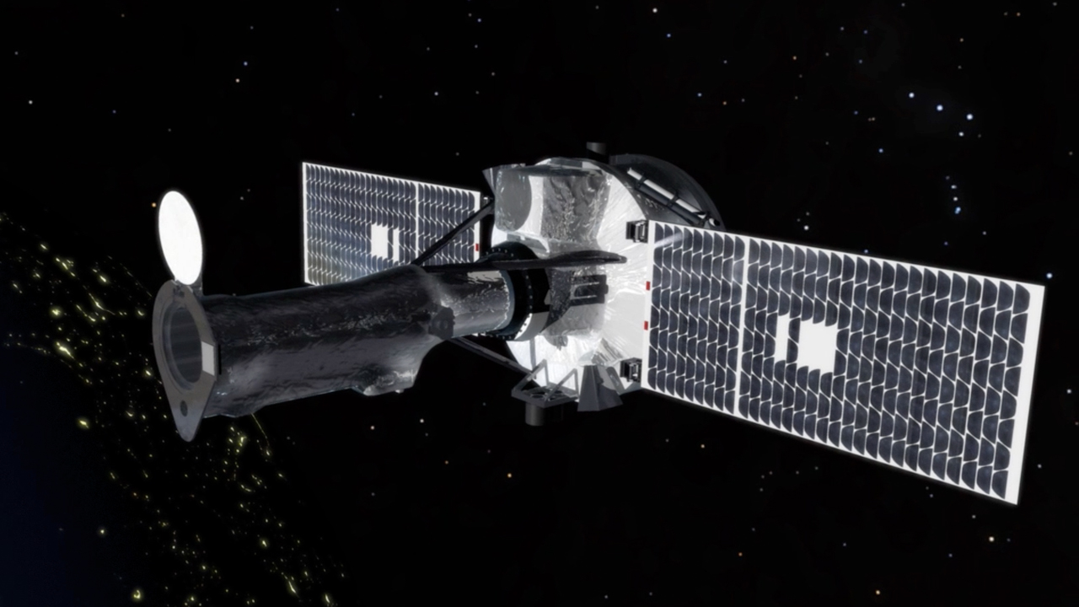
Curious scientists have learned a great deal about the Sun
NASA’s Solar Dynamics Observatory
NASA’s IRIS satellite
Notes:
Scientists around the world use their curiosity to study and understand the Sun. For more information, check out these NASA solar missions:
http://sdo.gsfc.nasa.gov/
http://iris.gsfc.nasa.gov/
http://stereo.gsfc.nasa.gov/mission/mission.shtml
http://lws.gsfc.nasa.gov/missions.html
Images courtesy NASA

Slide 19
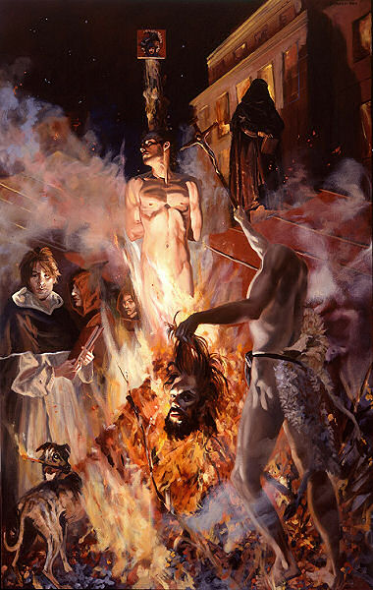
Science is a tool to counter misconceptions with evidence
How many of us believed that the Sun was the centre of the universe? How many did not?
Which had clear reasons for their beliefs based on evidence?
Notes:
Image: Giordano Bruno being burned at the stake for believing that the Earth went around the Sun.
Giordano Bruno by D.G. Ellis (April 1977)

Slide 20
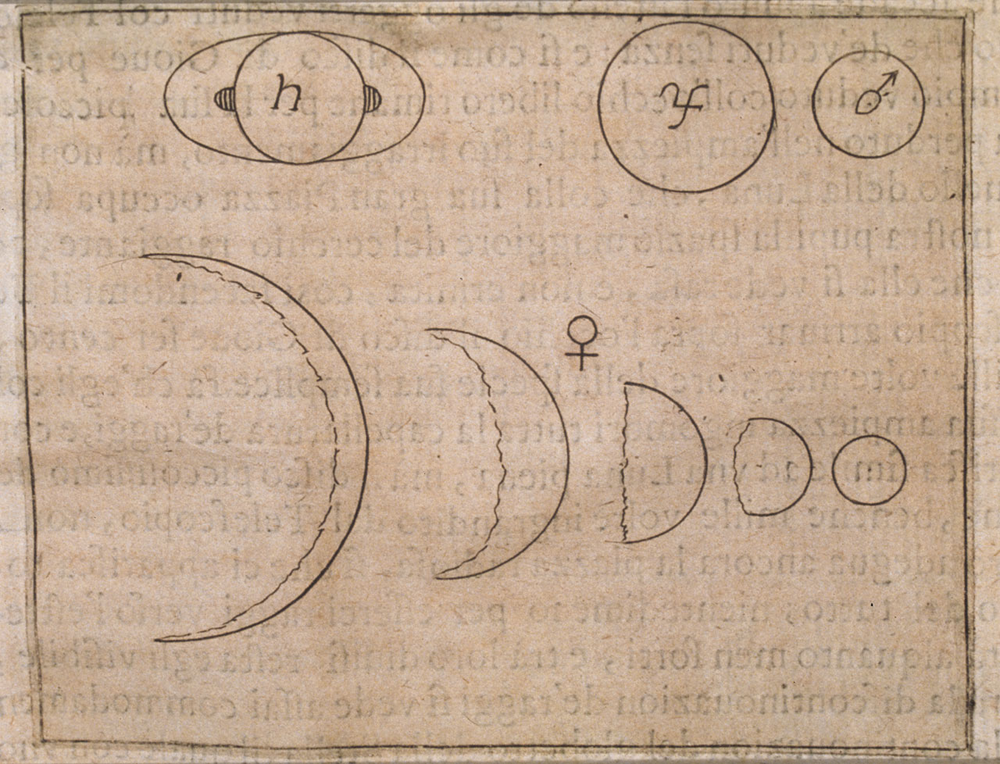
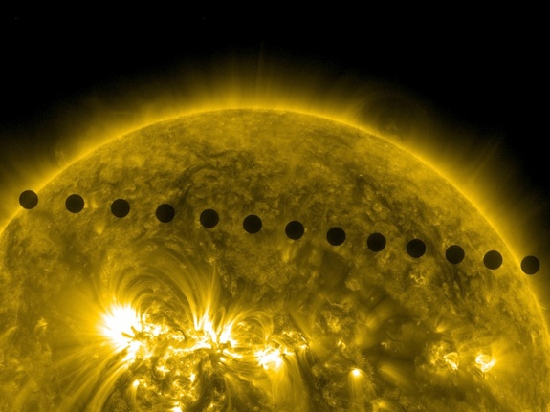
Evidence?
Galileo Galilei was put under house arrest even though he had irrefutable evidence.
Notes:
Nicholas Copernicus, a Polish scientist living about a century before Galileo, had already come up with the unorthodox idea that the Sun was at the center of the solar system. Galileo knew about and had accepted Copernicus's heliocentric (Sun-centered) theory. It was Galileo's observations of Venus that proved the theory. Using his telescope, Galileo found that Venus went through phases, just like our Moon. But, the nature of these phases could only be explained by Venus going around the Sun, not the Earth. Galileo concluded that Venus must travel around the Sun, passing at times behind and beyond it, rather than revolving directly around the Earth. Galileo's observations of the phases of Venus virtually proved that the Earth was not the center of the universe. It was this assertion which most angered the Church leaders of the time.
Graphic decription of Venus phases (in Il saggiatore, In Roma, appresso Giacomo Mascardi, 1623) Istituto e Museo di Storia della Scienza, Library, Florence, Rari 153
The engraving shows the planets Saturn, Jupiter, Mars and Venus (with its various phases), as they appeared to Galileo through the telescope.
Venus transit image courtesy of NASA/SDO/AIA

Slide 21
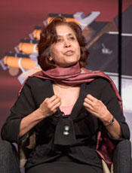
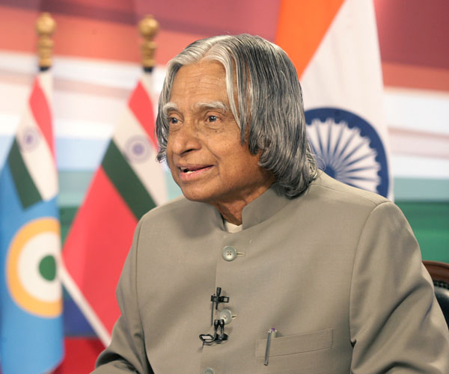
Science is a journey
True scientists are those who respect and understand evidence
They are not working to receive a Nobel Prize, but to determine the truth
Notes:
Left: Madhulika Guhathakurta, astrophysicist and lead scientist for NASA’s Living With a Star initiative
Right: A. P. J. Abdul Kalam, Indian scientist and administrator who served as the 11th President of India, from 2002-2007

Slide 22
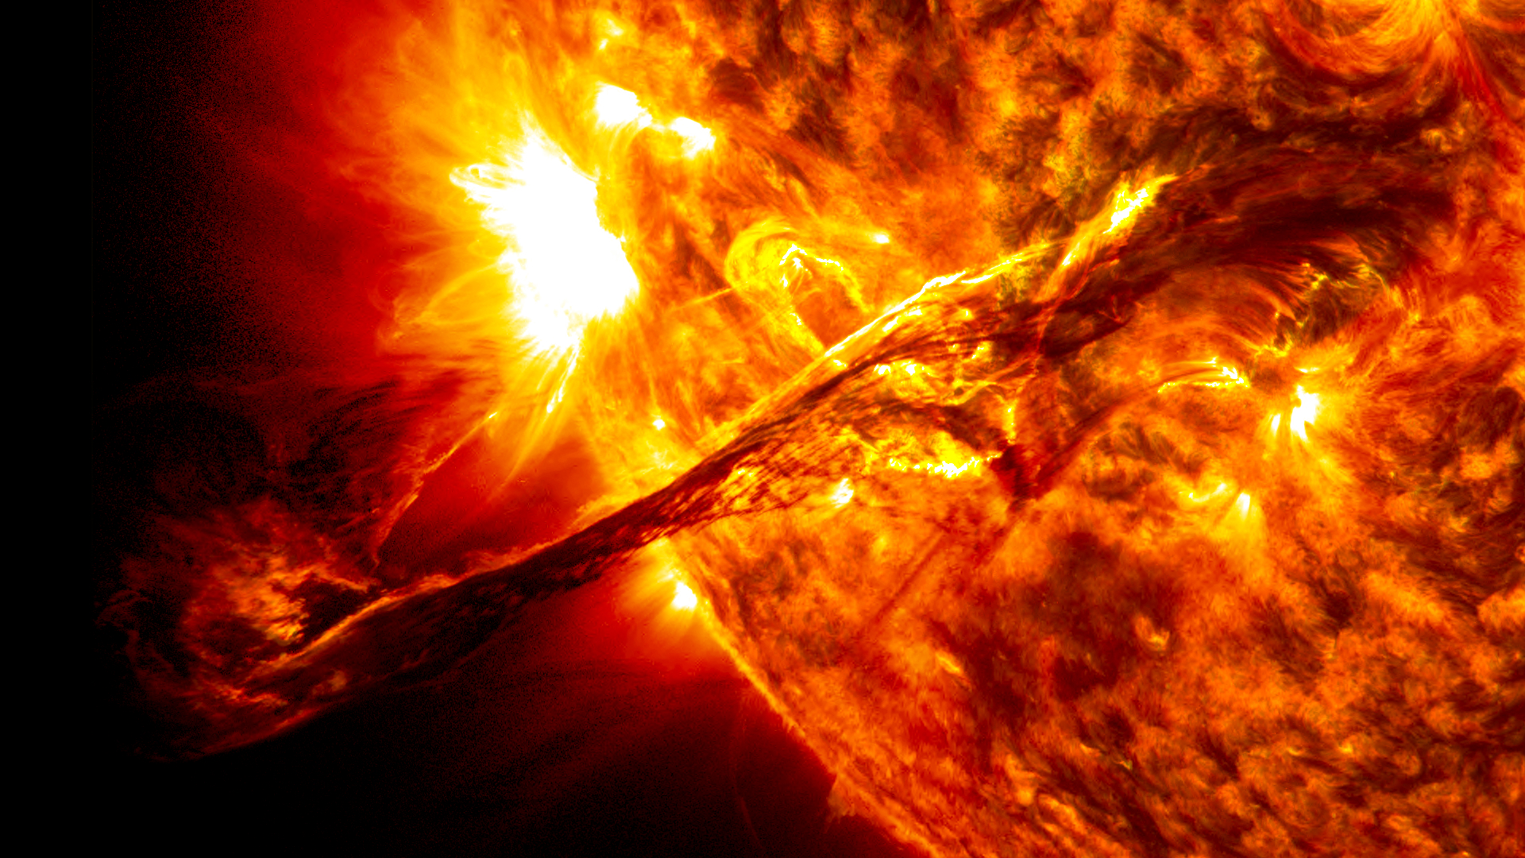
Seeking principles of Nature from within our inner world of curiosity and connecting them to the outside world of reality is the fundamental approach to learning science.
Notes:
Erupting giant prominence on the Sun
Credit: NASA SDO/AIA

