Slide 1
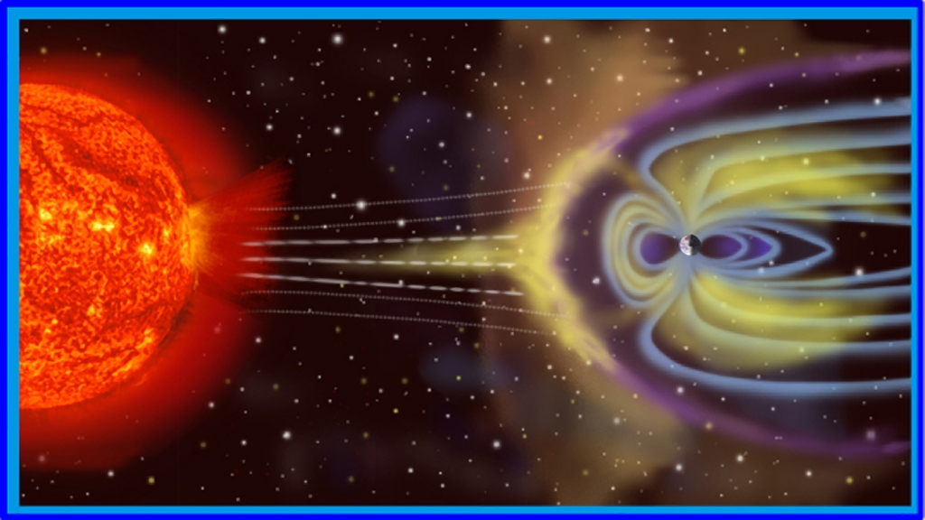
Magnetism & Solar Activity
Section 3 –
The Sun-Earth Connection
Deborah Scherrer
Stanford University

Slide 2
Section 3 – The Sun-Earth Connection
The Earth’s Magnetosphere
- Activity
The Solar Wind & its Affects - videos
Magnetic Storms from the Sun
- Activity
Space Weather on Earth
Space Weather and the Solar System
- Activity
Notes:
Students will explore the Earth’s magnetic field (magnetosphere) in the context of the solar wind. They will understand the extensive impact solar activity can have on the Earth its technology, and its life forms. Then they will extend what they have learned to understand how the Sun’s activity can also have a dramatic effect on space travel and much of the rest of the solar system.
.

Slide 3
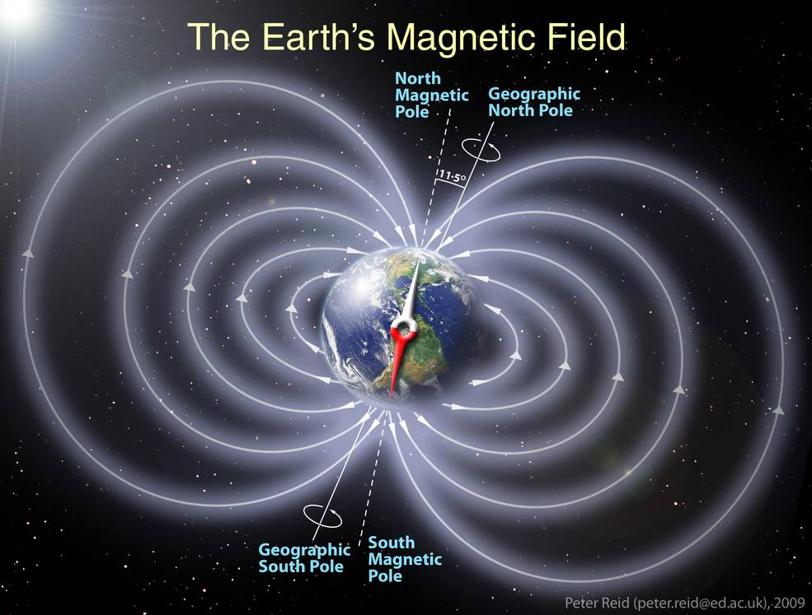
The Earth’s Magnetosphere
Notes:
The Earth’s Magnetosphere
“Magnetic fields around planets behave in much the same way as a bar magnet. But at high temperatures, metals lose their magnetic properties. So it’s clear that Earth’s hot iron core isn’t what creates the magnetic field around our planet.”
The Earth has a core of molten iron. The flowing of liquid metal in the outer core generates electric currents. The spinning of the Earth on it’s axis causes these currents to form a magnetic field which works its way up through the Earth and extends around the planet.
The Earth’s magnetic field is extremely important to sustaining life on Earth. Without it, large amounts of radiation from the Sun would bathe our planet, solar activity would threaten our technology, and our atmosphere would be free to leak out. This has most likely happen on Mars, a planet whose core has stopped churning and therefore has virtually little magnetic protective field.
See also: http://www.geomag.bgs.ac.uk/education/earthmag.html
Image credits: Schematic illustration of Earth's magnetic field.
Credits: Peter Reid, The University of Edinburg
https://cosmosmagazine.com/geoscience/what-creates-earth-s-magnetic-field

Slide 4
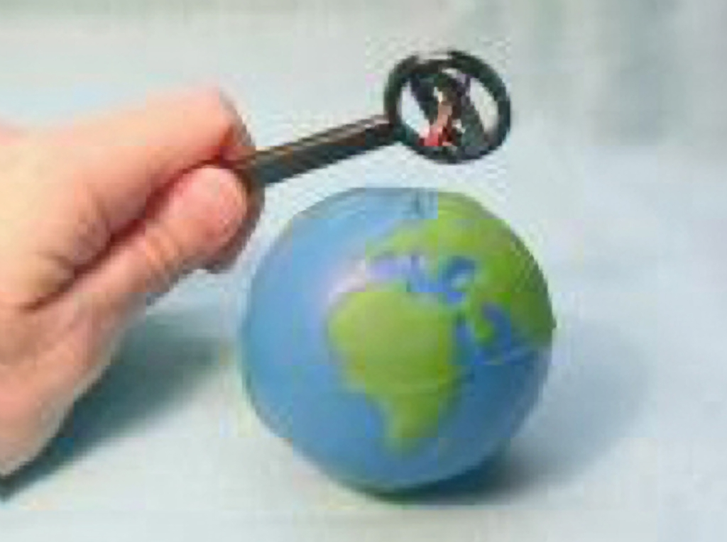
Exploring the Earth’s Magnetosphere
Activity 7 – Exploring the Earth’s Magnetic Field
The Earth’s magnetosphere is the area of space around the planet in which charged particles are controlled by the Earth’s magnetic field.
Notes:
Activity 7 – Exploring the Earth’s Magnetic Field – See Appendix J
Materials:
Small Earth ball with magnet inside (instructions for making these are in Appendix J)
Magnaprobe (instructions for these are in Appendix B)
Procedure:
Have the participants explore their Earth model with the Magnaprobe. Assure they notice that the magnetic field lines at the pole are perpendicular to the pole’s surface and that magnetic field lines at the equator are horizontal to the surface.
Ask students to discuss their findings.

Slide 5
A solar “wind” of charged particles from the Sun shapes Earth’s magnetosphere into a teardrop.
Note that the bar magnet showing the Earth’s magnetic poles is upside down.
Animation
Earth’s magnetosphere keeps us safe from dangerous solar radiation.
Notes:
The Solar Wind
Video: showing the solar wind’s impact on Earth’s magnetosphere
We have seen how the Earth has a large magnetic field, the magnetosphere, that emanates from near the Earth’s rotational poles and surrounds the planet. And we have seen that the Sun has millions of magnetic fields, emanating from its Convection Zone, and extending through its surface up into the solar corona.
What happens when these 2 magnetic systems interact?
The solar wind
Video shows how the solar wind shapes Earth’s magnetosphere.
Expanding coronal gas, or solar wind, fills interplanetary space. Solar magnetic fields embedded in the plasma are carried into space by the solar wind to form the interplanetary magnetic field. The solar wind streams from the Sun in all directions at about a million miles per hour (~1.5 million km/hr). The source of the solar wind is the Sun's hot corona, where temperatures are so high that the Sun's gravity cannot hold on to the plasma.
The solar wind is not uniform. Although it is always directed away from the Sun, it changes speed according to activity. High and low speed streams can interact with each other and alternately pass by the Earth and planets as the Sun rotates.
As we learned, the Earth’s magnetosphere would normally have a very uniform shape - like the field around a bar magnet (shown in the movie). However, due to the million km/hr electrically charged solar wind constantly buffeting the Earth, the shape of Earth’s magnetosphere is compressed on the side facing the Sun and stretched out on the side facing away. Variations in the solar wind speed can affect the Earth's magnetic field and produce storms in the Earth's magnetosphere.
Movie File: 6magnet4.avi

Slide 6
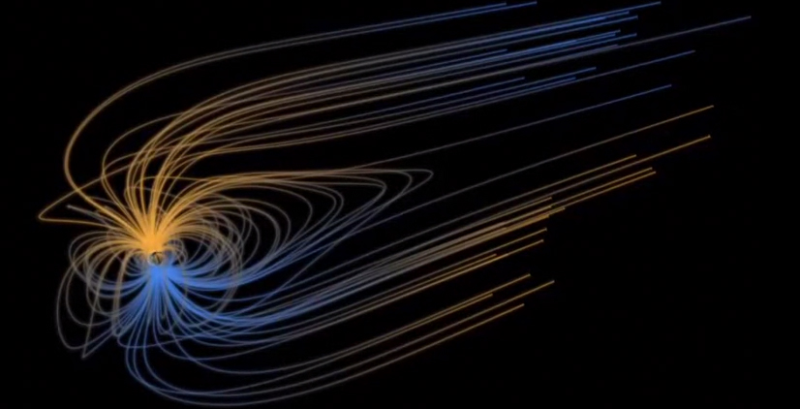
Earth’s Magnetosphere in 3D
Animation by NASA
Notes:
Video – 3D animation of the Earth’s magnetosphere
A glorious animation, with audio, of the Earth’s magnetosphere in 3D.
This video is provided for for its artistic content and to help students understand the nature of the Earth’s magnetic field in 3D.
Credit: NASA https://www.youtube.com/watch?v=k67OGI-ur3I

Slide 7
Real Data - The Earth’s magnetosphere is buffeted during a solar storm
Computer simulation
Notes:
The video is a computer simulation, based on actual data, of the Earth’s magnetosphere being buffeted by the solar wind and then changing shape as a coronal mass ejection impacts the Earth’s magnetic field. The simulation spans approximately 4 hours worth of data.
Here’s a description of the items you see:
The Earth is the small “ball” at the center point of the axes. You can see a red bar through the Earth, indicating the orientation of the Earth’s magnetic field.
The grey contours show the changing shape of the magnetosphere. The colors tell how much plasma is present – red indicating a high density and blue low.
As the simulation starts, the field is relatively normal. As the Earth becomes bombarded by the coronal mass ejection, the field turns almost completely red.
On the upper left is an arrow labeled “Pram”. This is the Solar Wind Dynamic (or Ram) Pressure, the pressure and direction the solar wind exerts on the Earth’s magnetosphere. One could think of it as the intensity of the ejection.
On the lower left a small compass indicates the direction and strength of the magnetic field in the ejection.
The circular inset on the lower right simulates where and what auroras would be seen if looking directly down at the Earth’s North Pole.
Image credit: Charles C. Goodrich, University of Maryland, Space and Plasma Physics Group GGS/University of Maryland Space Plasma Physics project. See http://www.spp.astro.umd.edu/htmls/JanCloud/jan10-11.html
Movie File: ion-ms-jan_6.mpg

Slide 8
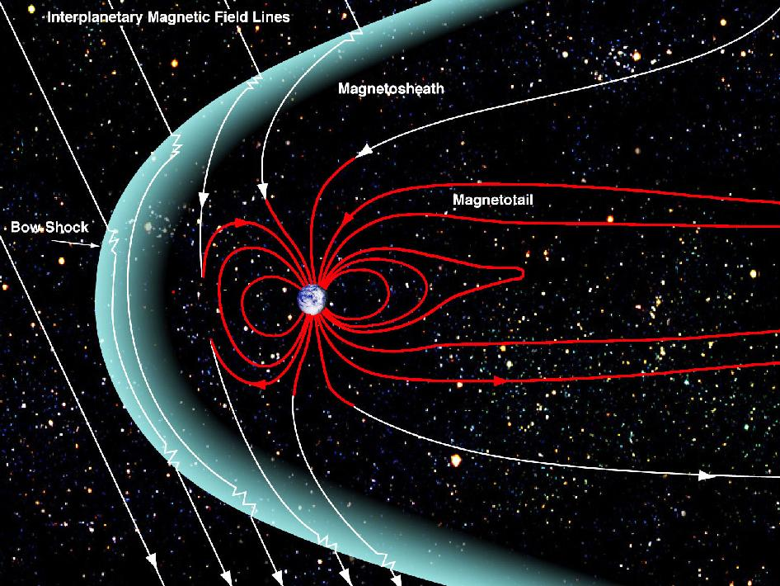
Magnetic Storms from the Sun
Activity 8
The magnitude of a geomagnetic storm is determined by the strength and direction of its magnetic field as well as the pressure of the solar wind.
Notes:
Activity 8 - Magnetic Field of a CME impacting the Earth = Appendix K
Activity developed by Deborah Scherrer, Stanford Solar Center.
Materials:
Worksheet from Appendix K
Pen or pencil
Procedure:
Provide the information below
Pass out the worksheet
Ask students to label the directions of the magnetic field in each of the drawings.
A geomagnetic storm is a temporary disturbance of the Earth’s magnetosphere caused by a solar event (e.g. Coronal Mass Ejection or a sudden high speed increase in the solar wind) that interacts with Earth’s magnetic field. The magnetic field from the Sun is present in the eruption. The increase in solar wind pressure compresses the magnetosphere and generates electric currents in the Earth’s magnetosphere and ionosphere.
The direction of the magnetism in the eruption will determine how much effect the storm has on Earth. If the solar wind field is pointing northward, it will generally slip by the Earth’s magnetosphere and little harm will be done. However, if the ejection has a southward direction, it will be conducive to magnetic reconnection (i.e. a repaid conversion of magnetic field to energy). -- meaning it will interact with, and integrate into, Earth’s magnetic field, rapidly injecting magnetic & particle energy into the Earth’s magnetosphere. It will also add to (and hence extend) the magnetotail and have direct access to the Earth’s poles. This can cause serious disruptions. Until scientists figure out how to determine a CME’s direction of magnetism before it reaches us, we will not be able to predict the severity of such dangerous solar storms.
See the Teachers Guide for the correct labeling.
This CME has a south-facing field, which is opposite the Earth’s magnetic field. Hence the fields will be conducive to magnetic reconnection and the CME will disrupt the Earth’s magnetosphere, causing a geomagnetic storm.
The CME above has a North-facing field, which is the same as the Earth’s. Therefore the Earth’s magnetosphere will “repel” the CME and it will cause little damage.
Image from: http://wormholeriders.org/science/?p=24505
NASA’s MMS mission is designed to study these particular events. See http://mms.gsfc.nasa.gov/

Slide 9
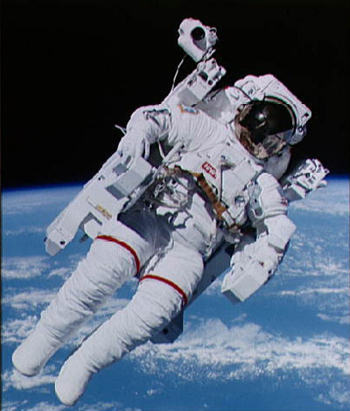
The Sun generates space weather in our solar system
Solar activity can have a dramatic impact on communications, satellites, astronauts, and animals.
Animation
Notes:
Space Weather
The Sun can generate conditions in space that have the potential to seriously affect Earth and other planets. We call these conditions "space weather". The causes can include radiation storms and ejections from the Sun as well as disturbances in the Earth's magnetic field caused by gusts of plasma from the Sun.
These geomagnetic storms can
Trigger beautiful aurora displays
Damage/destroy satellites
Disrupt power grids and electrical systems
Interfere with cell phones, GPS, and other communications
Cause ionospheric disturbances which interfere with radio communications
Cause expensive rerouting of aircraft away from the poles because of the threat to communications
Threaten astronauts and high-flying airplanes with their radiation!
Induce currents in pipelines, hence dramatically increasing corrosion rate
Disrupt animal movements and migrations (pigeons, bats, sea turtles, dolphins & whales, etc.) because these animals rely on the Earth’s magnetic field to find their way
Scientists are working to predict the occurrence of solar storms much like meteorologists predict weather on Earth.
Upper left movie: An animation of a satellite getting “fried” by a solar event. The arcing seen in this animation could damage electronics and permanently disable the satellite.
Image credits: Astronaut courtesy of NASA Movie File: sizzler.mov

Slide 10
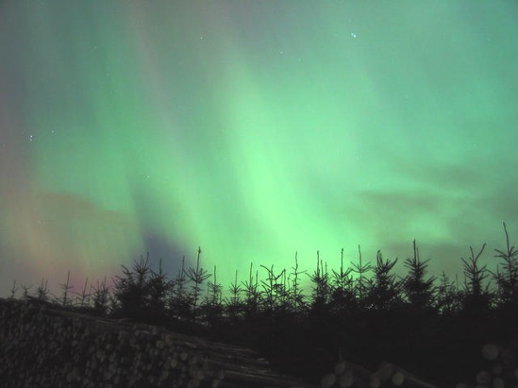
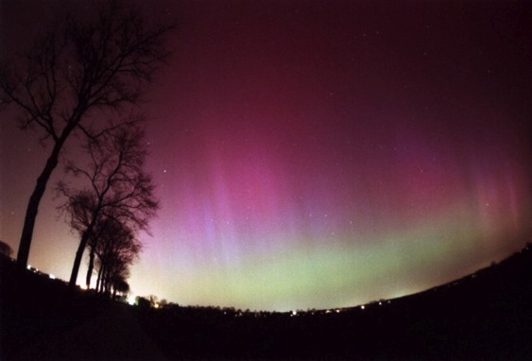
Solar activity causes colorful aurorae
Animation
Notes:
Video – solar activity produces aurorae
In the animation, a solar event sends a stream of charged particles towards Earth. The particles interact with the Earth’s magnetosphere. The particles follow the magnetic field lines into the magnetotail, where they break, then immediately meet in a reconnection. The particles then flow back to the Earth’s poles and interact with the gases in our atmosphere.
Aurorae, sometimes called Northern or Southern Lights, are beautiful displays of color in the high-latitude sky. The energy that drives the auroral currents comes from the action of the solar wind on the magnetosphere. High-energy particles become trapped in the Earth's magnetic field. As these particles spiral back and forth along the magnetic field lines, they come down into the atmosphere near the north and south magnetic poles where the magnetic field lines disappear into the body of the Earth.
The delicate colors are caused by energetic electrons colliding with oxygen and nitrogen molecules in the atmosphere. This excites the molecules, and when they decay from the excited states they emit the light that we see in the aurora. The aurora green color is due to atomic oxygen, whereas any blue color visible is from the interaction with nitrogen molecules.
Image Credits:
Upper left photograph of an aurora near Monikie, north of Dundee, Scotland, 30th October 2003. John Gilmour. From http://aurorawatch.lancs.ac.uk/ Lower left aurora photo by Craig M. Groshek from Wikipedia, released to the Public Domain.
Movie File: recon.mpg

Slide 11
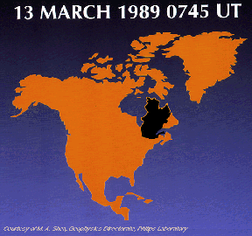
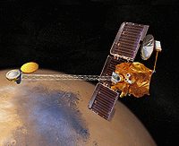
Solar storms threaten technology
In 1989, a solar storm caused 6 million people in Quebec to lose power for 9 hours.
A solar flare in 1997 killed the Telstar 401 satellite (which transmitted “Star Trek”).
An October 2003 solar storm knocked out the Mars Odyssey probe and destroyed transformers in South Africa, which took 4 months to repair.
Notes:
Solar storms threaten technology
In 1989 a large solar storm caused damage to a power station in Quebec and left 6 million people in Canada and the US without power for 9 hours.
A solar storm in October 2003 knocked out an instrument on NASA’s Mars Odyssey probe orbiting Mars. Ironically, the instrument was designed to assess the hazards humans would face if they were to visit the Red Planet.
The same October 2003 storm caused a blackout in Sweden, damaged two Japanese satellites and interfered with navigation and radio systems, and also crippled South Africa's power supply by damaging 15 large transformers. It was 4 months before full power was restored.
Image Credits: Mars Odyssey spacecraft, NASA

Slide 12
Notes:
Space weather affects the solar system
Since the Moon and Mars have neither atmosphere nor much of a magnetosphere, astronauts are at risk from solar radiation and X-rays. If astronauts were traveling to or walking about on the Moon or Mars during a significant solar storm, they might be debilitated or even killed! In fact, finding a way to protect astronauts is one of the key challenges of sending humans to Mars. More about this on the next slide.
Image Credits: Moon, Saturn, Jupiter, Neptune courtesy NASA
Mars Science Laboratory rover using ChemCam to analyze a rock. Artist's conception, courtesy French Space Agency (CNES) and Los Alamos National Laboratory.

Slide 13
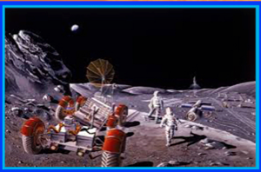
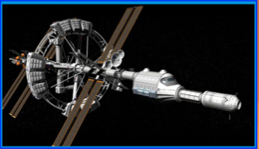
Space Weather Affects Traveling to the Moon and Mars
Notes:
Space weather on the Moon and Mars
Solar radiation is a key factor for astronaut safety as they venture to the Moon and eventually Mars. NASA is exploring a variety of techniques and technology to mitigate different types of radiation during space travel. Below are some excerpts from this excellent article:
https://www.nasa.gov/feature/goddard/2019/how-nasa-protects-astronauts-from-space-radiation-at-moon-mars-solar-cosmic-rays
“Radiation is energy packaged in electromagnetic waves or carried by particles. The energy is handed off when the wave or particle runs into something else, like an astronaut or a spacecraft. These electromagnetic waves are dangerous because they pass right through skin, shedding energy and fragmenting cells or DNA on their way. This damage can increase risk for cancer later in life, or in extreme cases, cause acute radiation sickness in the short-term.”
“On Earth, humans are safe from this harm. Earth’s protective magnetic bubble, the magnetosphere, deflects most solar particles. The atmosphere also quells any particles that do make it through. The International Space Station cruises through low-Earth orbit, within Earth’s protection, and the station’s hull helps shield crew members from radiation too.”
But beyond Earth’s safe magnetosphere, human explorers will face the harsh radiation of space. Not only solar radiation, but galactic cosmic rays, particles from long-gone, exploded stars elsewhere in the Milky Way — constantly bombard the solar system at near-light speeds.
“Going to the Moon will help NASA collect crucial data and develop the necessary tools and strategies to one day safely send human explorers to Mars. The journey to Mars will take much longer than a trip to the Moon, and crew members will face much more radiation exposure. And, unlike Earth, Mars has no magnetic field to divert radiation.”
Perhaps some of your students will become these planetary explorers!
See also:
https://www.space.com/34519-mars-space-weather-forecasting-critical-for-astronauts.html
https://www.astrobio.net/mars/space-weather-on-mars/
Image credit: A futuristic colony on the Moon
A model of the Hermes spacecraft, developed for the film “The Martian”.

Slide 14
Planetary Magnetospheres
Activity 9
Many, but not all, solar system planets & moons have magnetospheres.
Magnetospheres protect planets, and their moons, from dangerous radiation from the Sun
Without magnetospheres, it would be difficult for life to exist
Notes:
Planetary Magnetospheres
Activity 9: Planetary Magnetospheres – See Appendix L
Magnetospheres protect planets and moons from dangerous solar radiation. Earth’s Moon, Venus, Mercury, and Mars have only weak magnetospheres, making it difficult for humans to safely visit there. (Mercury does have a global dipole magnetic field that interacts with the solar wind to form a magnetosphere. It is probably maintained by a dynamo of free charges in its huge iron core. The field strength is only 1% of Earth's however. So it is the weakest planetary dipole field in the Solar System.)
Some theorize that life could not develop on a planet or moon without a magnetosphere.
Students will examine models of the various planets to locate their magnetic poles and hence identify the planet. A mysterious exoplanet is also included. See Appendix L for complete instructions.
Activity developed by Deborah Scherrer, Stanford Solar Center.

Slide 15
What are your questions?
Thank you!
Notes:
Image credit: NASA/SDO AIA instrument

