Slide 1
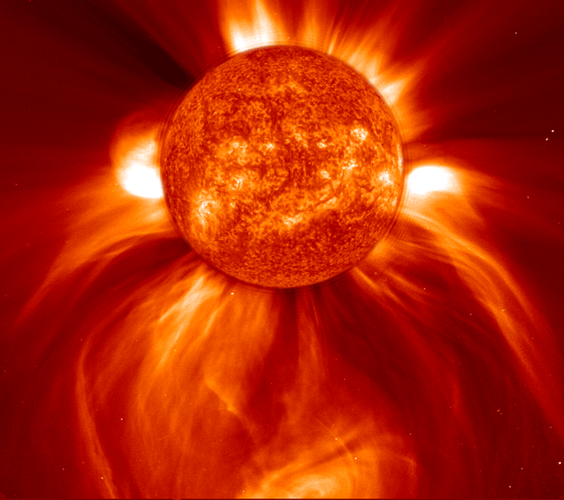
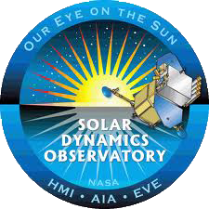
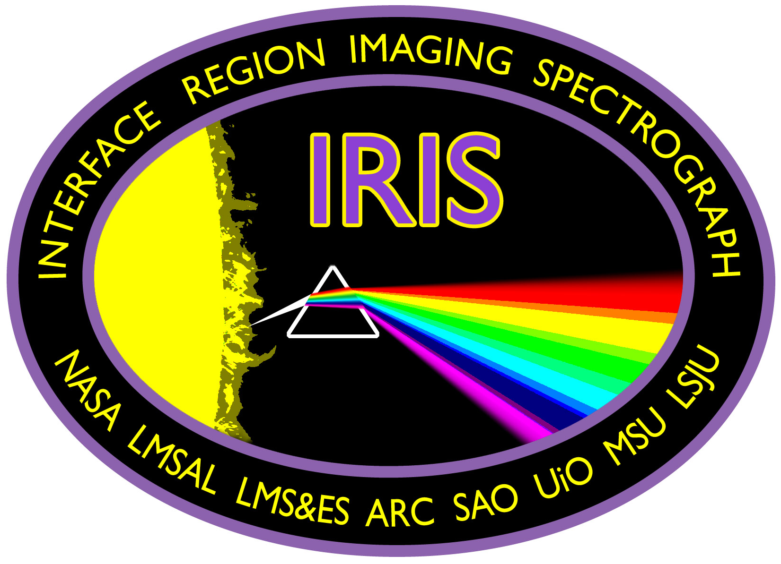
Fingerprints in Sunlight
Deborah Scherrer
Stanford University
Solar Center

Slide 2
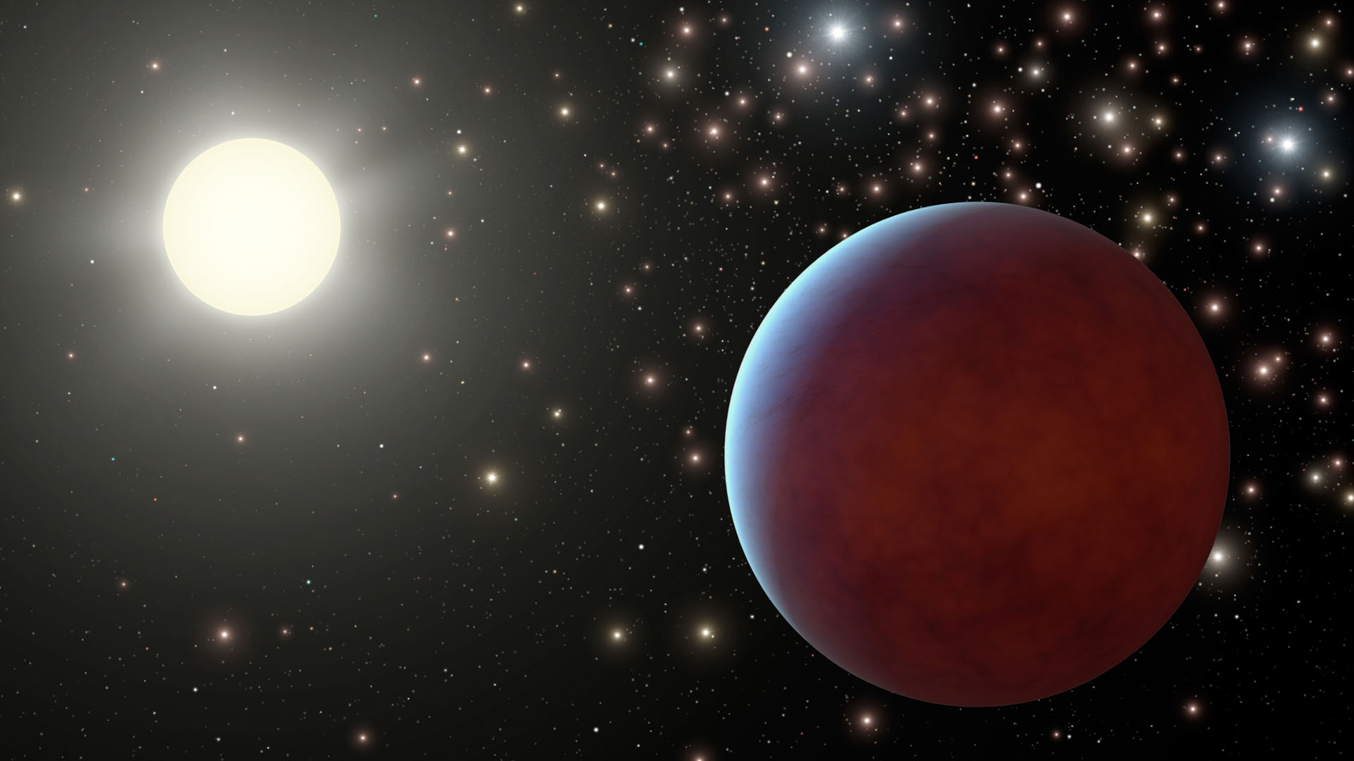
How can we study the stars & Sun?
No matter how good your telescope, a star is only a point of light
We can’t get there from here
Only/primary way of learning about distant objects is through their light (electromagnetic spectrum)
Light has ‘fingerprints” which provide information about it
How can we “read” these fingerprints and what do they tell us about the star?

Slide 3
What is the spectrum of light?
Anything hotter than absolute zero radiates/emits energy, i.e. light
Sun & stars emit a continuous spectrum (“black body”) of EM radiation
Our eyes see “white” light, which is made of a spectrum of colors, visible in a rainbow
Spectrum = “The distribution of energy emitted by a radiant source, e.g. the Sun, arranged in order of wavelengths”
Notes:
Image from http://climate.met.psu.edu/www_prod/data/frost/frosttraining.php

Slide 4
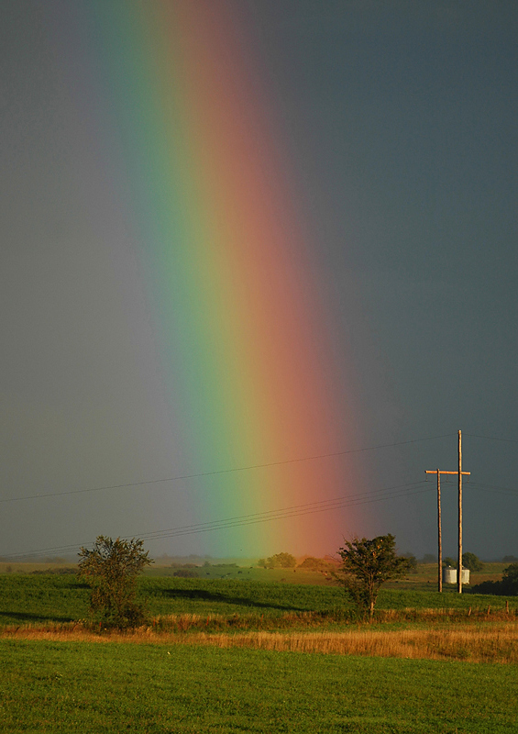
What is a spectrograph?
A relatively simple-to-understand scientific instrument to look at a spectrum
Like a prism – breaks light into its colors
Thin, rectangular slit produces a rectangle of light
Example output from a spectrograph

Slide 5
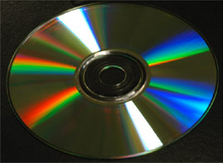
Your Simple Spectrograph
Diffraction grating
(similar effect to prism
or CD)
Slit & light source
Scale (optional)
Eye or instrument
for viewing
Examine & try out your spectrograph
Notes:
Have teachers experiment with their spectrographs by locating the key parts, then observing various light sources such as reflected sunlight, incandescent bulbs, fluorescent bulbs, whatever is available.

Slide 6
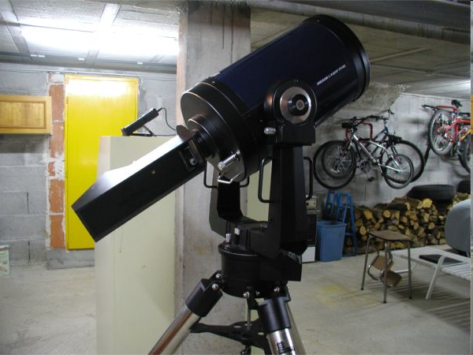
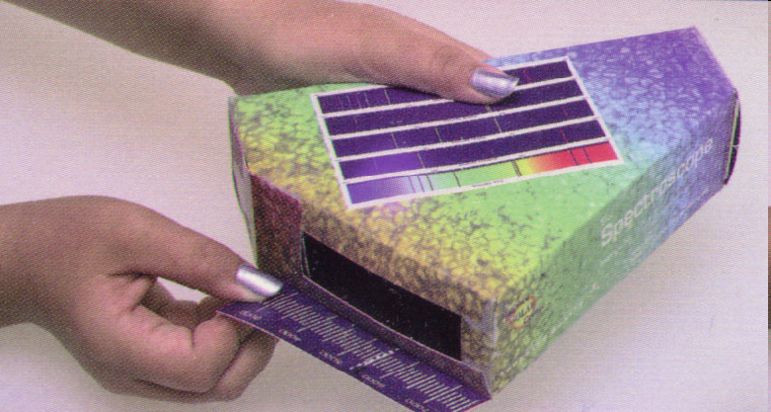
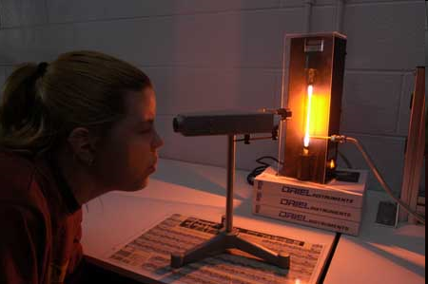
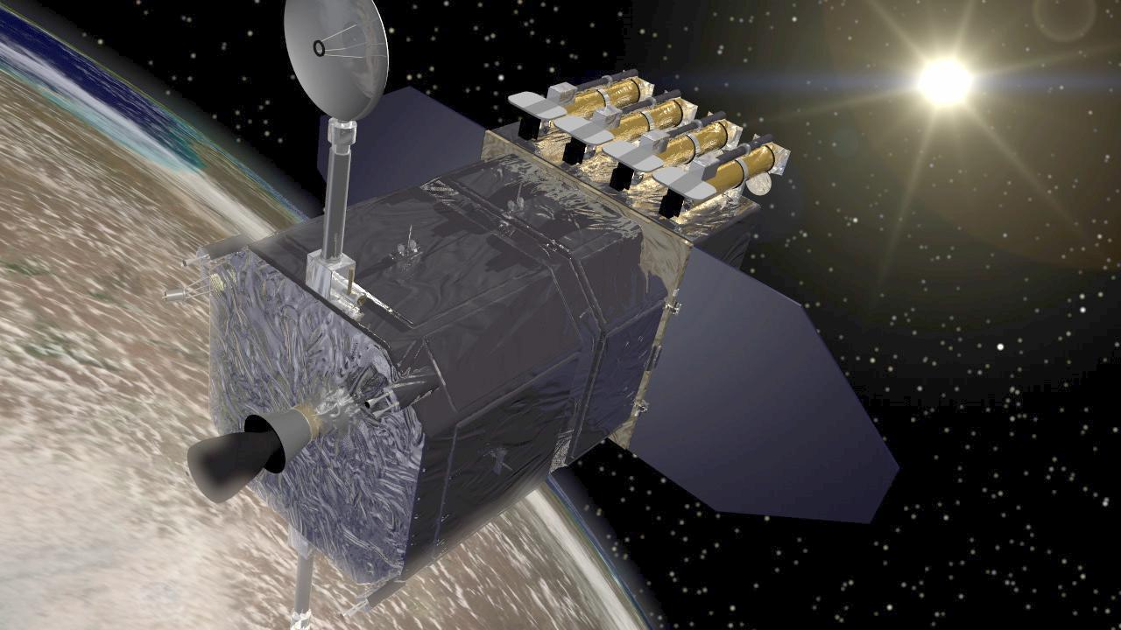
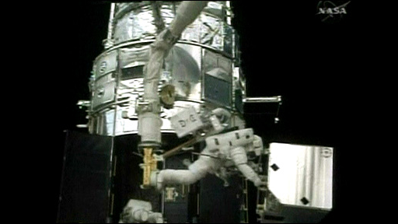
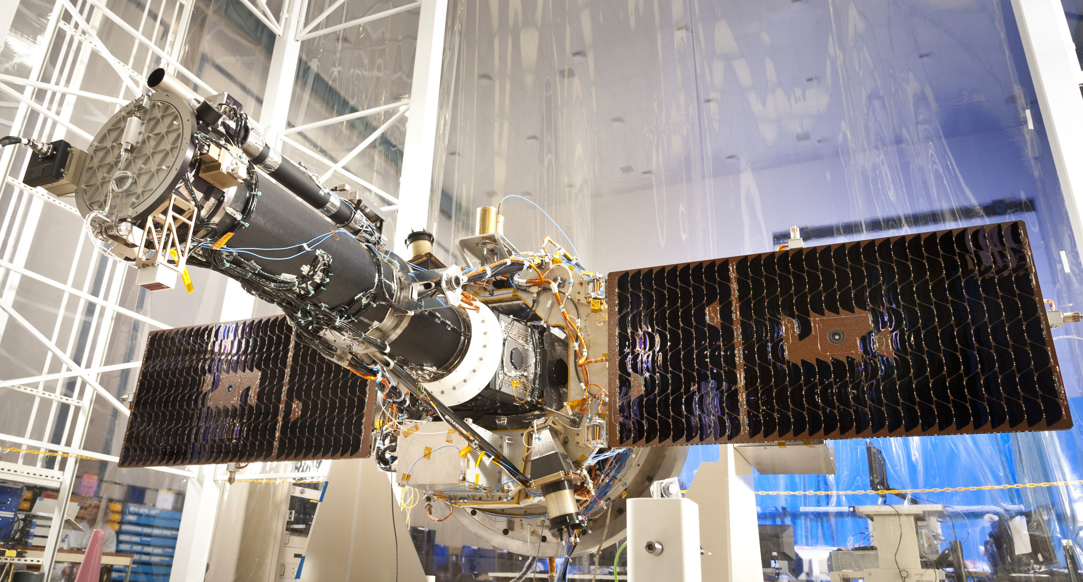
Most astronomy is done with spectrographs!
Your spectrograph
Stanford Solar Center
Home-made spectrograph attached to telescope
Student spectrograph & gas lamp
NASA’s Solar Dynamics Observatory (SDO) Spacecraft
NASA’s IRIS Mission
Hubble’s Cosmic Origins Spectrograph
Notes:
Home-made spectroscope attached to telescope: http://www.astrosurf.com/aras/dearden/SGSpectro1.htm
Hubble’s new Cosmic Origins Spectrograph (COS): http://news.bbc.co.uk/2/hi/science/nature/8054135.stm

Slide 7
What can we learn with a spectrograph?
Sometimes there are extra bright colors
Sometimes there are missing colors
To ultraviolet
To infrared

Slide 8
Fingerprints in Light
The extra or missing colors indicate certain chemical elements have affected the light
Each chemical element changes the spectrum either by making certain colors brighter or removing certain colors
Each chemical element has a different and unique pattern of colors, hence the “fingerprints”

Slide 9
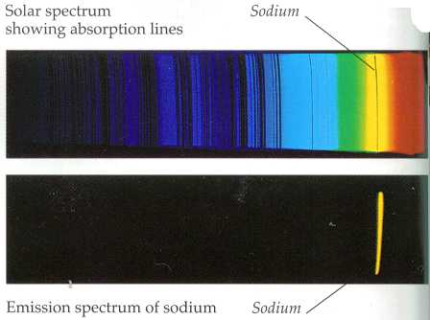
Example fingerprints
Hydrogen
Helium
Sodium

Slide 10
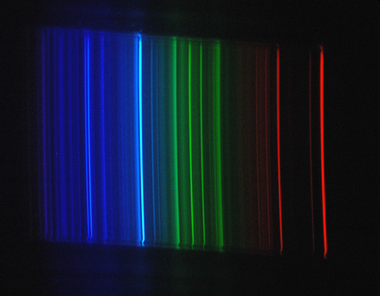
Some Elements on the Sun
Hydrogen (H)
Helium (He)
Sodium (Na)
Oxygen (O₂₎
Iron (Fe)
Sun
Notes:
The Fraunhofer C, F, G', and h lines correspond to the alpha, beta, gamma and delta lines of the Balmer series of emission lines of the hydrogen atom. The D1 and D2 lines form the well-known "sodium doublet", the centre wavelength of which (589.29 nm) is given the designation letter "D".
Note that there is disagreement in the literature for some line designations; e.g., the Fraunhofer d-line may refer to the cyan iron line at 466.814 nm, or alternatively to the yellow helium line (also labeled D3) at 587.5618 nm. Similarly, there is ambiguity with reference to the e-line, since it can refer to the spectral lines of both iron (Fe) and mercury (Hg). In order to resolve ambiguities that arise in usage, ambiguous Fraunhofer line designations are preceded by the element with which they are associated (e.g., Mercury e-line and Helium d-line).

Slide 11
What does it mean “lines”?
Hydrogen lines
We call these chemical fingerprints “lines”, because they show up in our spectrograph as thin rectangles, from our rectangular slit
Absorption lines – produced when a chemical element has absorbed energy
Emission lines – produced when a chemical element has emitted energy
Lines can show up in any part of the EM spectrum (not just visible light)

Slide 12
Let’s try an example
Point your spectrograph to an incandescent light or sunlight
Next, point your spectrograph to a fluorescent light bulb
What do you see? Especially notice the bright green line

Slide 13
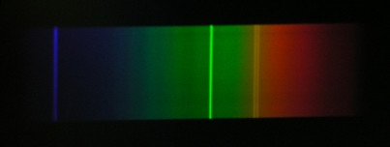
You should have seen a continuous spectrum with some extra bright colored lines
Fluorescent bulb, old style
Fluorescent bulb, new style
Mercury
What do you conclude?
Notes:
Florescent bulbs include mercury (which is why, in the US, they are not allowed into landfills)

Slide 14
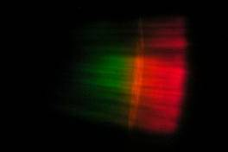
Another experiment
Work in teams
Take your candle
Burn a hollow around your wick
Put salt in the hollow, or pour salt onto the flame
Look for a brief flash
What do you see?

Slide 15
What did you see?
The candle
Sodium spectrum
What is salt?
Sodium chloride

Slide 16
Is there sodium on the Sun?
Solar spectrum
Sodium spectrum
Notes:
Take a break after this slide.

Slide 17
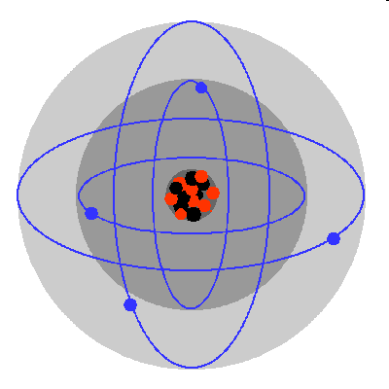
How does this work?
Atoms are a nucleus surrounded by shells or “energy levels” of electrons
Different chemical elements have different levels where electrons can live
Electrons can be knocked up levels, or down levels
Electrons can be knocked off completely (atom becomes ionized)
Lost electrons can be recaptured
Instructor will demonstrate
Notes:
Begin demo of nested electron shells here

Slide 18
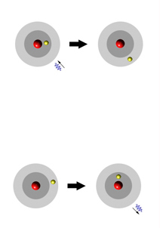
Energy Levels
Energy absorbed – electron jumps up
To move from one level or another requires ENERGY
Movement from one specific energy level to another requires a specific amount of energy
Higher levels require more energy
Energy is conserved, never lost
Energy released – electron jumps down
Each element requires different sets or collections of these “amounts of energy”
Instructor will demonstrate… Any questions?
Notes:
Explain the diagram and ask for questions

Slide 19
Photons
An “amount of energy” is essentially a photon, or a packet of light
Photons come in only certain “sizes”, or amounts of energy
Light then consist of little photons, or quanta, each with an energy of Planck's constant times its frequency.
Planck's constant = 6.626068 × 10⁻³⁴ m² kg / s
Your colored straws are representations of photons of various energies.
Notes:
In 1900, Max Planck was working on the problem of how the radiation an object emits is related to its temperature. He came up with a formula that agreed very closely with experimental data, but the formula only made sense if he assumed that the energy of a vibrating molecule was quantized--that is, it could only take on certain values. The energy would have to be proportional to the frequency of vibration, and it seemed to come in little "chunks" of the frequency multiplied by a certain constant. This constant came to be known as Planck's constant, or h, and it has the value Planck's constant = 6.626068 × 10-34 m2 kg / s
It was an extremely radical idea to suggest that energy could only come in discrete lumps, even if the lumps were very small. Planck actually didn't realize how revolutionary his work was at the time; he thought he was just fudging the math to come up with the "right answer," and was convinced that someone else would come up with a better explanation for his formula.
Based on Planck's work, Einstein proposed that light also delivers its energy in chunks; light would then consist of little particles, or quanta, called photons, each with an energy of Planck's constant times its frequency.
Higher-frequency photons have more energy, so they should make the electrons come flying out faster; thus, switching to light with the same intensity but a higher frequency should increase the maximum kinetic energy of the emitted electrons. If you leave the frequency the same but crank up the intensity, more electrons should come out (because there are more photons to hit them), but they won't come out any faster, because each individual photon still has the same energy.
And if the frequency is low enough, then none of the photons will have enough energy to knock an electron out of an atom. So if you use really low-frequency light, you shouldn't get any electrons, no matter how high the intensity is. Whereas if you use a high frequency, you should still knock out some electrons even if the intensity is very low.
Image from: http://www.humanthermodynamics.com/

Slide 20
Hydrogen, an example
Hydrogen has 1 electron
From it’s resting state, Level 1, this electron can move to a number of other levels, e.g. Level 2, Level 4, Level “n”
The energy required to move between any 2 levels is specific for hydrogen & for each chemical element
Level 1 to level 2
absorbs a 122 nm
photon of energy
from “outside”
Level 2 to level 1
emits a 122 nm
photon of energy

Slide 21
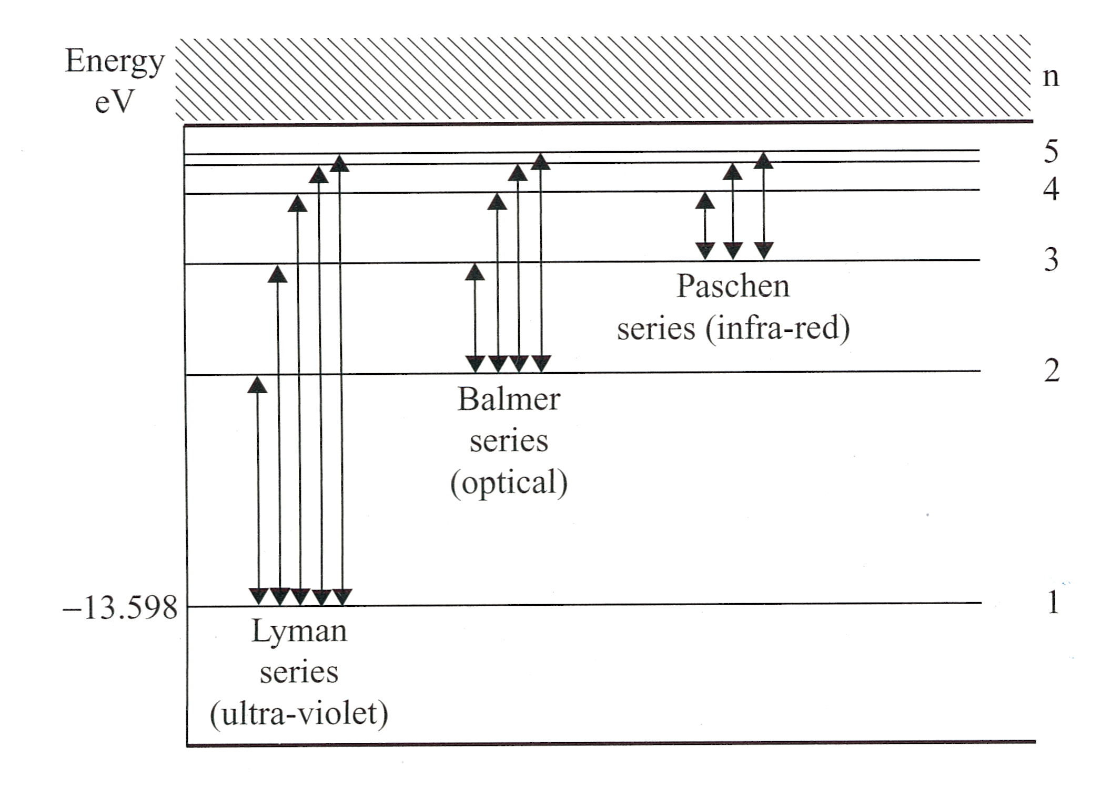
Hydrogen, still
Electrons can skip levels, up or down
Some skips to/from certain levels have names
For example, the hydrogen Balmer Series – any skips that start or end at Level 2
Balmer Series, any skips that originate
or end at Level 2

Slide 22
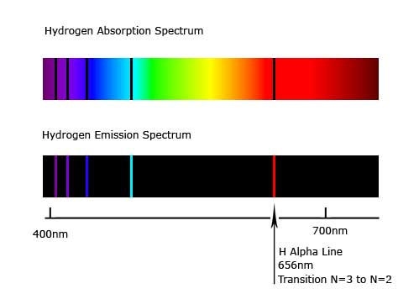
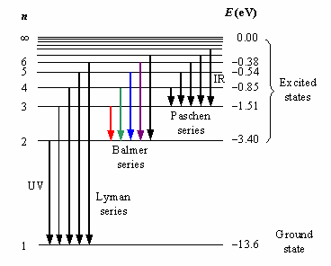
Why is the Balmer Series interesting?
Luckily for us, the skips to and from Level 2 in hydrogen emit or absorb photons of visible light!

Slide 23
Let’s Play
Take out your straws, styrofoam balls, sticks, and spectra sheet
6 -> 2
5 -> 2
4 -> 2
3 -> 2
<- Higher energy
Lower energy ->
Notes:
Demonstrate the straws/photons and the atom here. May take some time.

Slide 24
Questions on any of these concepts?
Next I’ll quickly explain what is an H-alpha solar telescope. These are the most common form of amateur solar telescopes.

Slide 25
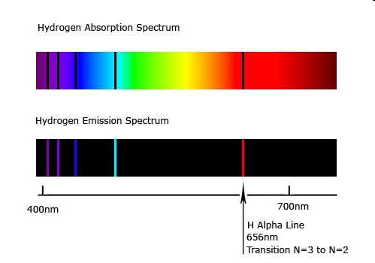
H alpha
H alpha is the name of the transition of
electrons in hydrogen between Levels 2 and 3
(656 nm). i.e. your red (pink) straw

Slide 26
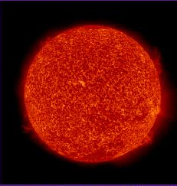
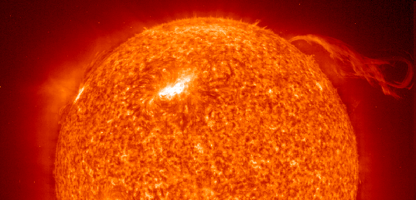
The Sun “in H alpha”
Hydrogen alpha filters allow only light in the 656nm wavelength to pass through. This is the line that appears in the red part of the spectrum when an electron moves from Level 3 to Level 2.
This allows us to see light produced at a particular temperature in the photosphere (surface) of the Sun.

Slide 27
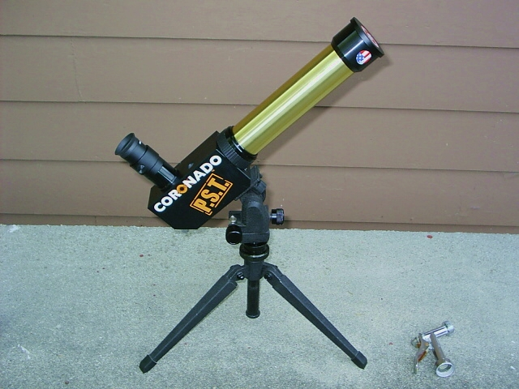
Questions on H-alpha solar telescopes?

Slide 28
Absorption & Emission
Notes:
Absorption Line Spectrum
If there is an absorbing material (such as a cloud of cooler gas) between you and the blackbody, then you will not see a completely continuous spectrum. The image shows a cloud of cool gas between the blackbody and us, and says that we see an "absorption line spectrum," an almost-continuous spectrum, if you will. Like a gold prospector, panning for gold in a pile of dirt, the cloud of cool gas is "looking" for certain types of light in the "pile of light" (the continuous spectrum) coming from the blackbody. If the prospector finds a nugget, he gets excited and keeps it, but passes along the dirt (who collects dirt?). Similarly, if the gas cloud finds light at a wavelength (color) that excites its atoms, the gas cloud will keep that light. But will transmit the light that is unexciting. In this way, gas cloud plucks out certain colors from the continuous spectrum before passing the rest on to us, the observers. So what do we see? An absorption line spectrum. An almost-continuous spectrum that has certain colors removed (absorbed).
Key Points:
Clouds of gas absorb certain wavelengths (colors) of light
A continuous spectrum that hits a cloud of cool gas will be partially absorbed
The transmitted spectrum is called an absorption line spectrum (because certain lines are absorbed), and is continuous except for the colors that were absorbed by the gas.
Emission Line Spectrum
The cool gas cloud does not ONLY absorb. In fact, anything that absorbs must also emit. If we look at only the cloud of gas (i.e. without the blackbody in our line of sight), we will see an emission line spectrum. The question is, as always, why?. Well, we know that the cloud of gas absorbs certain wavelengths of light from the blackbody. Each absorbed photon excited one atom in the gas. But an excited atom will not stay excited forever. Eventually, the excited atom will return to its unexcited (or, "ground") state. The ground state has less energy than the excited state, and because we know that energy must be conserved, the atom will emit a photon whose wavelength (color) is exactly the same as the photon it initially absorbed. So a cloud of cool gas that absorbs certain colors of light will also emit those same colors. If we look at the cool gas without the blackbody in the line of sight, we will see an emission line spectrum, and the colors of the lines we see are exactly the same colors that were missing from the absorption line spectrum.
Key Points:
Anything that absorbs also emits.
A cloud of cool gas that absorbs certain colors from a blackbody will emit exactly those colors as the gas atoms de-excite
If we look at the cloud without the blackbody in our line of sight, we will see an emission line spectrum.

Slide 29
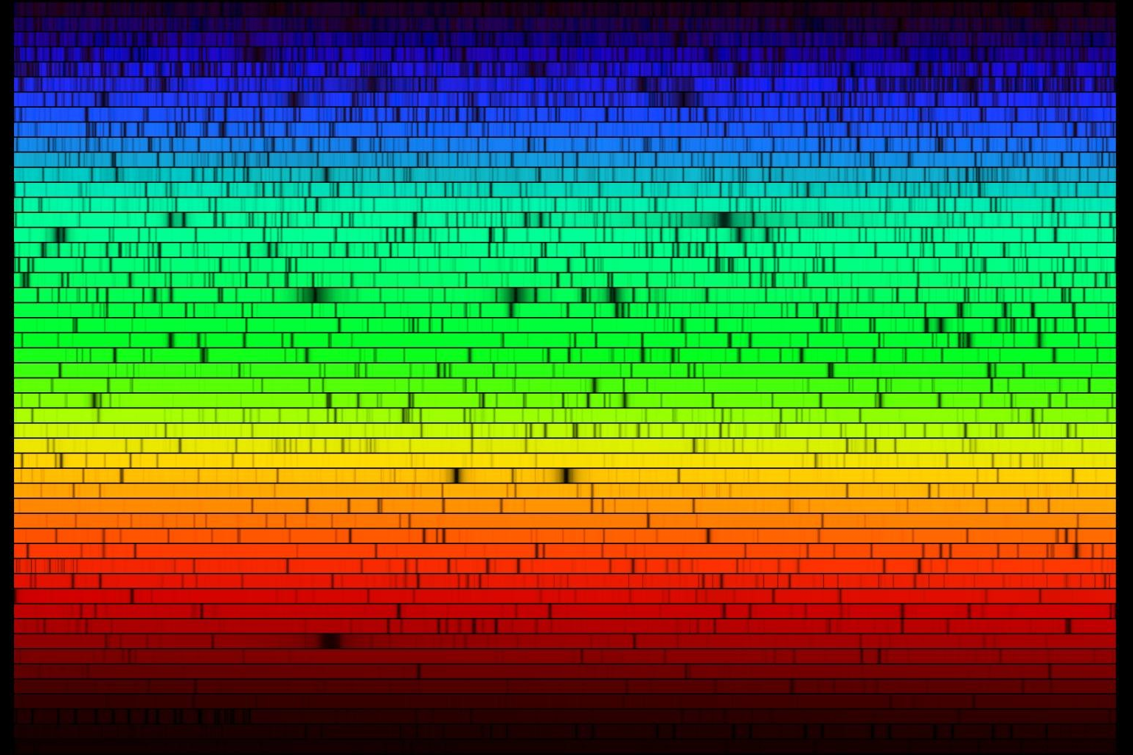
Absorption and Emission on the Sun
The Sun emits a continuous spectrum
All light from the Sun comes from the surface, or photosphere, 5800 degrees K
As the atoms bounce around the photosphere, photons are constantly being absorbed and re-emitted
Although the original light was traveling our way, re-emitted photons are sent off in all directions so most of them never make it to our instruments
The result is a continuous spectrum with absorption lines
A high resolution really long spectrum, chopped into lines sliced and stacked on top of each other

Slide 30
Absorption in the solar spectrum

Slide 31
What secrets do spectra tell us?
Temperature
Composition
Movement
Magnetic fields

Slide 32
Reading a spectrum
A spectrum can be graphed as wavelength vs. intensity
Location and shape changes of the line give us a lot of additional information
Measure Here

Slide 33
Spectra tell us temperatures
If you look at the strongest colors or wavelength of light emitted by a star, then you can calculate its temperature
temperature in degrees Kelvin =
3 x 10⁶/ wavelength in nanometers = 5800 K on the surface of our Sun

Slide 34
Spectra tell us about composition
Am emission or absorption line means a specific chemical element has been involved with the light you are seeing
Careful, though. The element could be from the source, or from an intervening plasma or gas cloud

Slide 35
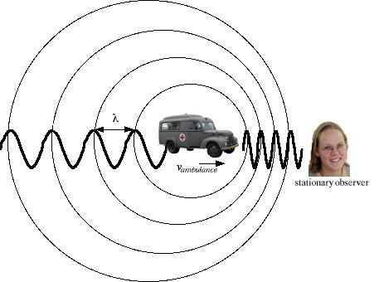
How do spectra tell us about movement?
A Doppler shift happens when an object is moving towards or away from us, as in a siren coming towards us
Wavelength is influenced by the movement
It works with sound, with light, with any wave
Notes:
Need a toy or something to demonstrate Doppler Shift

Slide 36
Doppler Shifts tell us about motions
Hydrogen spectrum
in lab
Hydrogen spectrum in
a distant moving object
Spectral line in Lab
is at 643.6 nm
Spectral line shifted to
666.4 nm in source.
Speed of source = 300,000 x (666.4 – 643.6)/643.6 = +10,628 km/s
Notes:
Thanks to Sten Odenwald for his permission to use this slide

Slide 37
Doppler, continued
Motion away from us results in a “red shift”
Motion towards us results in a “blue shift
Why don’t they call it a violet shift?
Notes:
We don’t call it a violet shift because the human eye does not see violet very well. Scientists tend to think of the visible light spectrum as red, yellow, green, and blue.

Slide 38
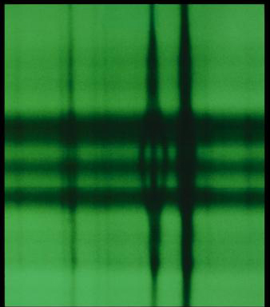
Spectra tell us about magnetism
Sunspots are magnetic storms on the Sun
Magnetic fields cause spectral lines to split into thirds

Slide 39
NASA’s Solar Dynamics Observatory (SDO)
Launched Feb 2010
3 instruments, primary of which is Helioseismic Magnetic Imager (HMI)
HMI is from the Solar Observatories team at Stanford – my group!
HMI works similarly to a spectroscope

Slide 40
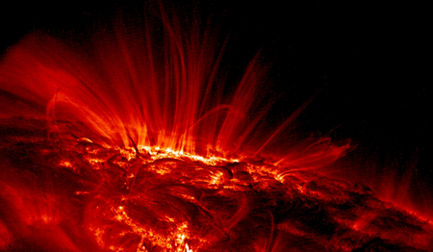
NASA’s IRIS Mission IRIS is a spectrograph!
Scientists from our group at Stanford and from Lockheed work on IRIS!

Slide 41
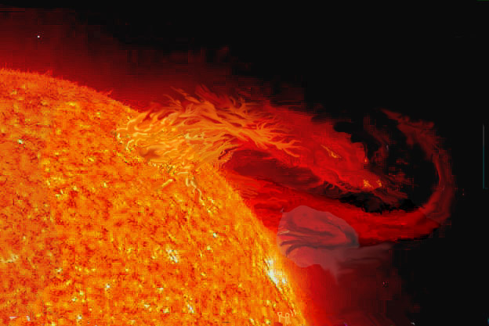
What are your questions?
Thank you!
Sun Dragon Art image © by Henry Roll. Used with permission.
You can obtain punch-out spectrographs from the Stanford Solar Center.
http://solar-center.stanford.edu/activities/cots.html
Use them to look at moonlight, reflected sunlight, fluorescent lights, neon signs, mercury vapor and sodium streetlights, etc.
Notes:
The original image came from one of NASA’s twin STEREO spacecrafts, observed on 29 September 2008 in the 304 wavelength of extreme UV light. This prominence, a relatively cool cloud of gas suspended about the Sun and controller by magnetic forces, rose up and cascaded to the right over several hours as it broke apart and headed into space. The material observed is actually ionized helium at about 60,000 degrees K.
More information and videos of the original image are available at: http://stereo.gsfc.nasa.gov/gallery/item.php?gid=1&id=80

